Slide 1

Basics of Photosynthesis C₃, C₄ and CAM Dr. Stella Aspelmeier Albrecht-von-Haller Institute for Plant Sciences Georg-August University Göttingen Juni 2020
Notes:
This lecture recaps the basics of the photosynthetic reactions, the light reaction and the Calvin cycle.

Slide 2
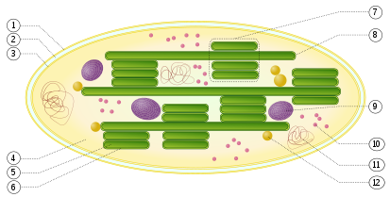
Structure of the chloroplast
granum (stack of thylakoids)
outer membrane
intermembrane space
thylakoid lamella
inner membrane
starch
ribosome
stroma
plastidial DNA
thylakoid lumen
drop of lipids
thylakoid membrane
verändert nach https://en.wikipedia.org/wiki/Photosynthesis#/media/File:Chloroplast.svg
Notes:
This picture recaps the structure of a C3-plant chloroplast:
The chloroplast is surrounded by a double membrane consisting of outer and inner membrane and the intermembrane space between them
It is filled with a liquid solution, the stroma – this is where the Calvin-cycle enzymes work
The chloroplast contains an inner membrane structure of thylakoid membranes. These surround an intermembrane space as well, the so-called lumen
Thylakoid membranes can be either stacked – then they are called granum or not, then they are calle lamella- thylakoids. The membranes and lumen of the granae are the site where the light reactions take place.
chloroplasts contain, especially in the evening, granules of starch and drops of lipids
and they contain plasitidial DNA and the ribosomes to translate it into proteins, a heritage of their bacterial ancestors.

Slide 3
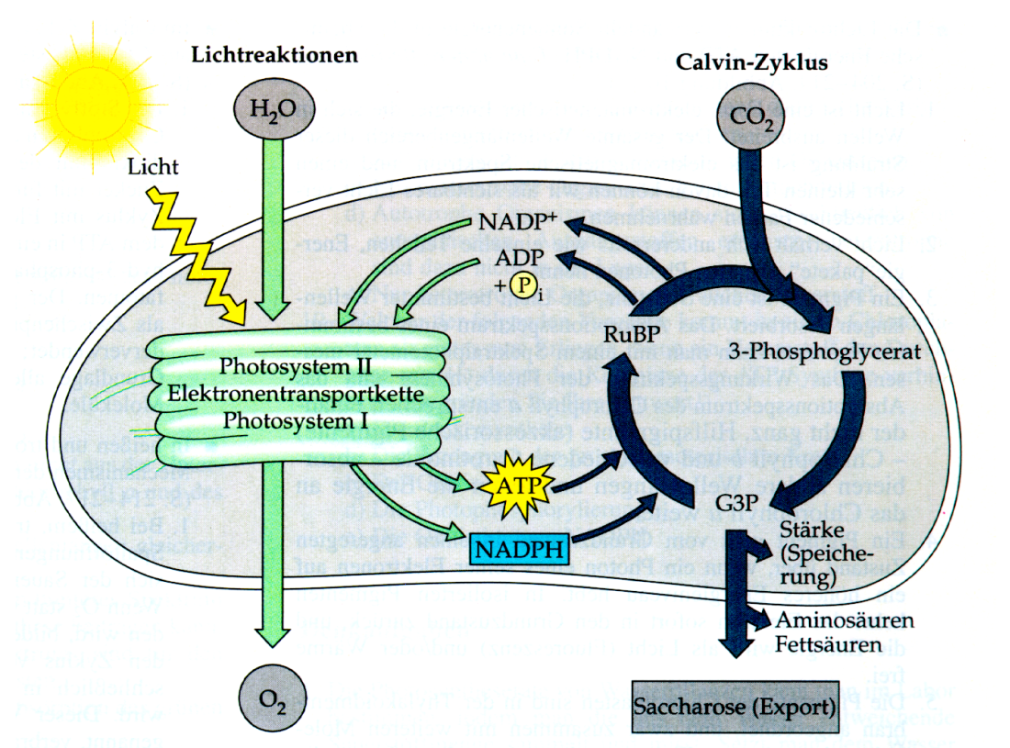
Interaction of Light reaction and Calvin Cycle
Light reactions
Calvin-cycle
Light
Electron transport chain
starch
(storage)
Amino acids
Fatty acids
Glucose (export)
Notes:
This slide summarizes the interaction of light reaction and Calvin cycle in the chloroplasts. The light reaction takes place in the stacked parts of the thylakoid membranes, the granae. Here the energy of light is used to excite electrons in the photosystems and to transfer them to NADPH. Water is split into protons – hydrogen ions – an oxygen and the resulting proton gradient is used to build ATP, which is basically chemical energy. Both NADPH and ATP are used in the Calvin cycle to reduce Carbondioxide to sugar.

Slide 4
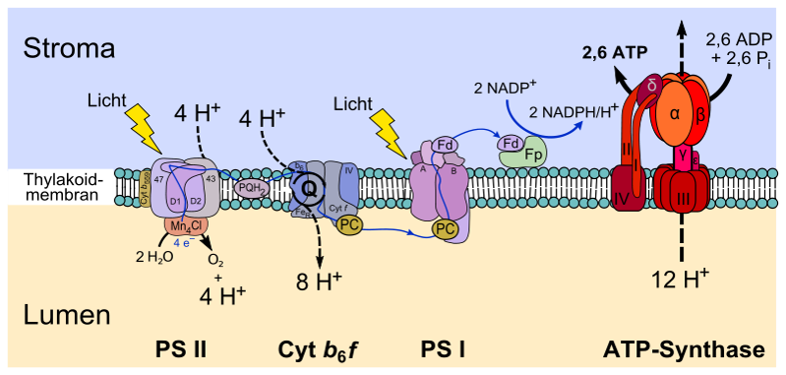
Interaction of Light reaction and Calvin Cycle
I
Notes:
This is a picture of part of the thylakoid membrane in a granum, separating the stroma from the intermembrane liquid, the lumen. Inside the membrane lie the components of light reactions:
photosystem II
and photosystem I, where photons of light are absorbed and electrons are excited
the electron transport chain in between them, with the
plastoquinone-pool, cytochrome b6f complex and plastocyanin. Excited electrons in the reaction centre of PS II reduce plastoquinone and are then transferred via Cytochrome b6f and Plastocyan to PS I. here they excited again and transferred
via an enzyme called Ferredoxin-NADP+-Reductase to NADP+, which is thus reduced to NADPH/H+.
the loss of electrons in PS II is subsequently replaced by electrons from the splitting of water, which takes place at the water-splitting complex
the cytochrome b6f-complex works as a proton pump that uses the energy of the electron transport to pump protons – H+-ions – against a concentration gradient from the stroma into the lumen.
ATP-synthase, an enzyme that tunnels the thylakoid membrane and connects Lumen and Stroma, uses this protongradient to combine the „energy storage molecule“ ATP – adenosine triphosphate – from ADP – adenosine diphosphate – and anorganic phosphate.

Slide 5
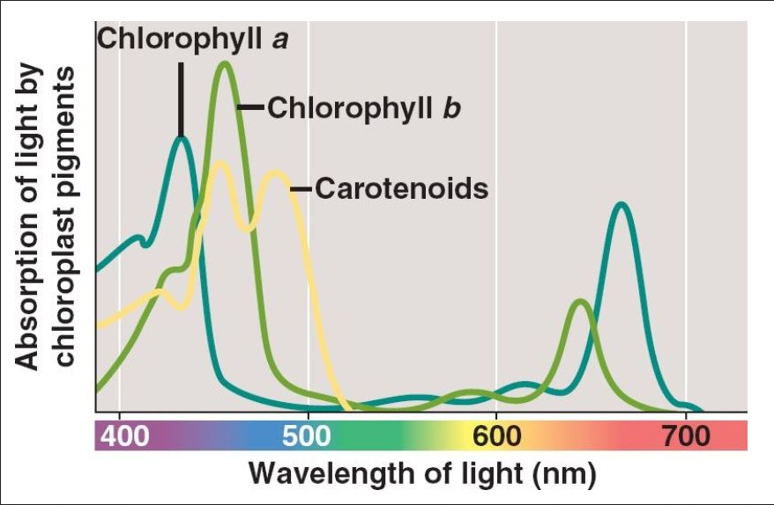
Light absorption of the chlorophylls
high energy
high energy
low energy
Notes:
Only photons of certain wavelengths can be utilized by the plants to excite electrons. This graph shows the wavelength in nanometers (10⁻⁹ m) and their colours in the visible spectrum on the X-axis.
Absorption of these wavelengths, absorption spectra are shown for chlorophyll a and b and for several carotinoids present in the chloroplasts.
Chlorophyll a shows absorption peaks at about 430 and 660nm, chlorophyll b at 4560 and 640nm. The spectrum of the carotenoids peaks at ca. 440 to 550 nm. Of the visible spectrum, the chlorophylls reflect only the green wavelengths, hence their green colour. the carotinoids reflect mainly yellow and red light and consequently are orange.
Remember: the shorter the wavelength of a photon, the higher its energy

Slide 6
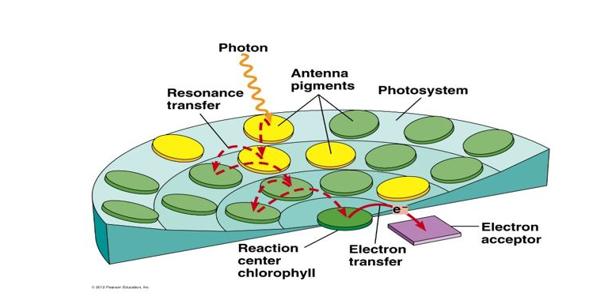
Antenna / Light-Harvesting-Complex (LHC)
Notes:
Each photosystem consists of two main parts – the Light harvestng Complex LHC or antenna and the reaction centre.
In the LHC, photons are absorbed by chlorophyll a and b molecules and by carotinoids such as ß-carotene. The absorbed photons excite electrons in the pigments.
In the LHC, distance and angle between molecules enable the transfer of energy between them – if an excited electron in one molecule returns to its ground state, most of the previously absorbed energy can be transferred to a neighbouring molecule to excite electrons there. This transfer is called „Förster resonance energy transfer“ – picture a ball hitting another ball so that it jumps off the ground, that is roughly how it works.
In this way, the energy from the absorption of a photon is transferred through the light-harvesting complex until it reaches the reaction centre and its central chlorophyll.

Slide 7
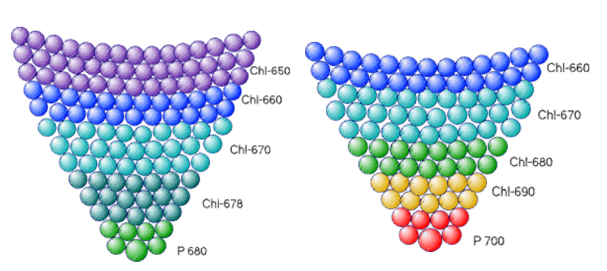
Transfer of exitation energy in Light-harvesting-complexes (LHC)
LHC PS II LHC PS I
Excitation of an electron by a photon
Excitation of an elecron by transfer of excitation energy
(Förster-resonance transfer))
Separation of charge, photochemical reaction
Transfer of an electron from P II to
Pheophytin (electron transfer chain)
Transfer of an electron from PS I to
Ferredoxin-NADP+-Reductase (→ NADP⁺→NADPH+H⁺)
Notes:
Picture the LHCs as funnels which „catch“ the light and transfer its energy towards the reaction centres of the photosystems.
Here the LHC of both photosystems are pictured, PS II on the left and PS I on the right. The yellow arrows depict the excitation of an electron by absorption of a photon, the red arrows the transfer of excitation energy via Förster-resonance. With each transfer step, a small amount of the original energy of the photon is lost, the chlorophylls further down – nearer to the reaction centre, are excited with subsequently less energy, which equals subsequently longer wavelengths.
The central chlorophyll a molecule in the reaction centre of PS II is excited by an amount of energy equalling that of a photon of 680nm wavelength, hence it is called P680.
The central chlorophyll a in the reaction centre of PS I is excited with an „energy parcel“ that equals that of a 700nm-photon, it is called P700.
In the reaction centres, the excited electrons do not return to their ground state and transfer the energy to another electron, but the excited electrons themselves are transferred to the first acceptor in the electron transport chain in PS II, to Ferredoxin in PS I. Charge separation takes place, which is a photochemical reaction or photochemical work.

Slide 8
Light reaction of photosynthesis
Light
12 H₂O + 12 NADP⁺ + 18 ADP + 18 P_{i} 12 NADPH+H⁺ + 18 ATP + 6 O₂
Notes:
This is the chemical equation of the light reactions, scaled up to the number of NADPH+H⁺ needed to reduce one molecule of glucose in the Calvin cycle.
12 H₂O, 12 NADP⁺, 18 ADP and 18 anorganic phosphate react with the energy delivered by photons to form 12 NADPH+H⁺, that is 24 high-energy electrons with a negativ redox potential on 12 carriers, and 18 ATP, storage molecules of chemical energy and 6 O₂

Slide 9
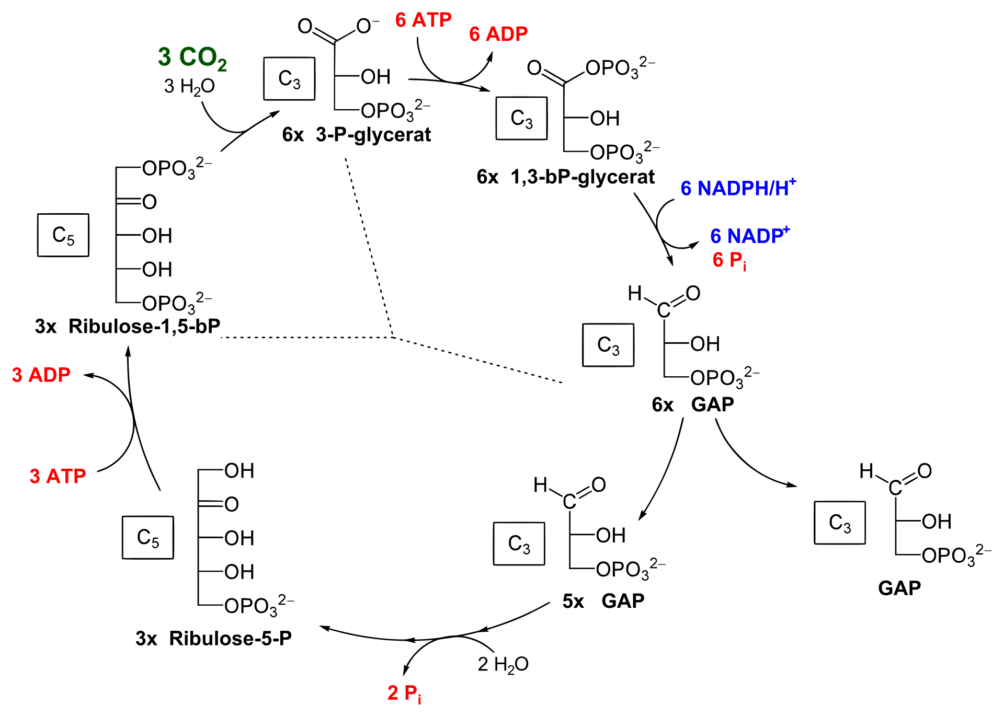
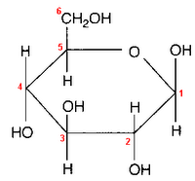
Calvin cycle → Reduction of 6 CO₂ to C₆H₁₂O₆
Carboxylation
Reduction
Regeneration
+
Glyceraldehyde-3-phosphate
Glucose
Aus Wikipedia, modifiziert
Notes:
In the Calvin cycle, both the high-energy electrons of NADPH+H⁺ and the chemical energy of ATP are used to reduce 6 carbondioxide to one glucose C₆H₁₂O₆
To form one C6-molecule glucose from two C3-molecules Glyceraldehyde-3-phosphate GAP the cycle must „run“ two times.
→ The first step of the Cycle is the carboxylation of 3 C5-molecules Ribulose-1,5-bisphosphate with 3 CO₂. This stept is catalysed by the enzyme Ribulose-1,5-bisphosphate Carboxylase / Oxigenase – Rubisco for short.
the result are 6 C3-molecules 3-phosphoglycerate.
→ These 6 3-P-glycerate are then phosphorylated using 6 ATP and reduced with the electrons from 6 NADPH+H⁺ to form 6 glyceraldehyde-3-phosphate GAP . In the process, the 6 ATP are de-phosphorylated to 6 ADP, the 6 NADPH+H⁺ are oxidised to 6 NADP⁺.
→ Of of the 6 GAP only one is used for the synthesis of glucose, the other 5 are regenerated in a process consuming 3 more ATP to form 3 Ribulose-1,5-bisphosphate again.

Slide 10
Chemical equation of photosynthesis
Light reaction
12 H₂O + 12 NADP⁺ + 18 ADP + 18 P_{i} 12 NADPH+H⁺ + 18 ATP + 6 O₂
Calvin cycle
6 CO₂ + 12 NADPH+H⁺ + 18 ATP C₆H₁₂O₆ + 6 H₂O + 12 NADP⁺ + 18 ADP + 18 P_{i}
Gross equation of photosynthesis
6 CO₂ + 12 H₂O C₆H₁₂O₆ + 6 H₂O + 6 O₂
Notes:
Here you see the chemical equations of light reactions
and calvin cycle.
if you combine the 12 molecules of water split and the 6 oxygen evolved in the light reactions,
with the 6 carbondioxide used to produce one glucose and the 6 molecules of water evolved in the Calvin cyle
you get the gross equation of photosynthesis: 6 CO₂ + 12 H₂O → C₆H₁₂O₆ + 6 H₂O + 6 O₂

Slide 11
Assimilation - Dissimilation
Photosynthesis – Assimilation
6 CO₂ + 12 H₂O C₆H₁₂O₆ + 6 H₂O + 6 O₂
Dissimilation
C₆H₁₂O₆ + 6 O₂ 6 CO₂ + 12 H₂O
∆G = - 2875 kJ
Notes:
Dissimilation is the reversed process of assimilation:
glucose is broken down to 6 carbondioxide and 12 water. The energy of light, that was used to reduce CO₂ to glucose in photosynthesis is released in the dissimilation of this glucose – the free energy of dissimilatin is – 2875 kJoule per mol glucose

Slide 12
Special forms of photosynthesis: C₄ and CAM
Notes:
This lecture is the first in a series on the environmental influences on photosynthesis. We ar going to start with responses to light.

Slide 13
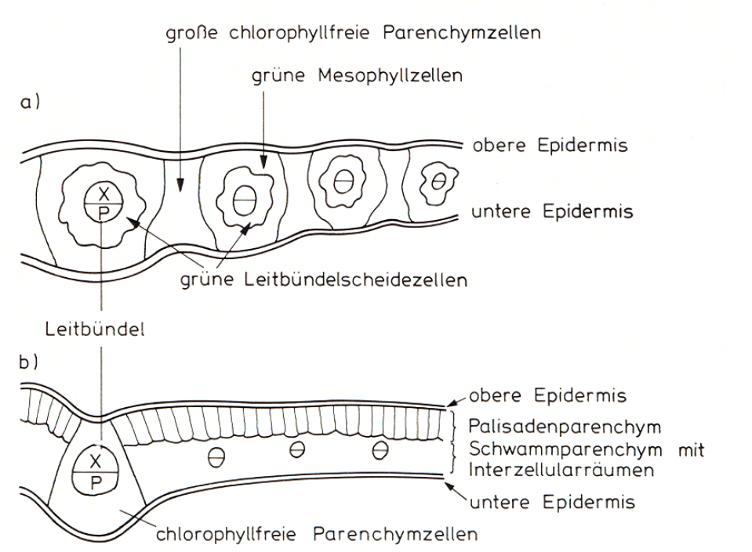
Anatomy of C₄-plants
schematic cross-sections of leaves of a C₄-grass (top) and a C₃-gras (bottom)
big paranchymatic cells without chloroplasts
mesophyll cells with chloroplasts
upper epidermis
lower epidermis
Light green bundle sheath cells
vascular bundles
upper epidermis
palisade mesophyll
spongy mesophyll
lower epidermis
paranchymatic cells without chloroplasts
Notes:
Leaves of C4 plants can be distinguished from C3 plants by their anatomy: where C3 plants show the typical anatomy with palisade parenchym and mesophyll, as seen in the lower cross section, C4-plants show the so-called „Kranz“ anatomy.
Around each vascular bundle, a ring or open U of light green bundle sheath cells forms the inner ring of this Kranz, surrounded by darker green ring or U of mesophyll cells. These double-rings are often divided by big parenchamatic cells without chloroplasts.

Slide 14
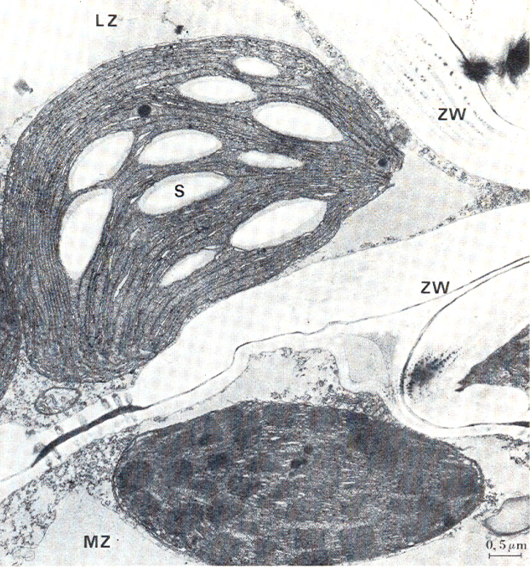
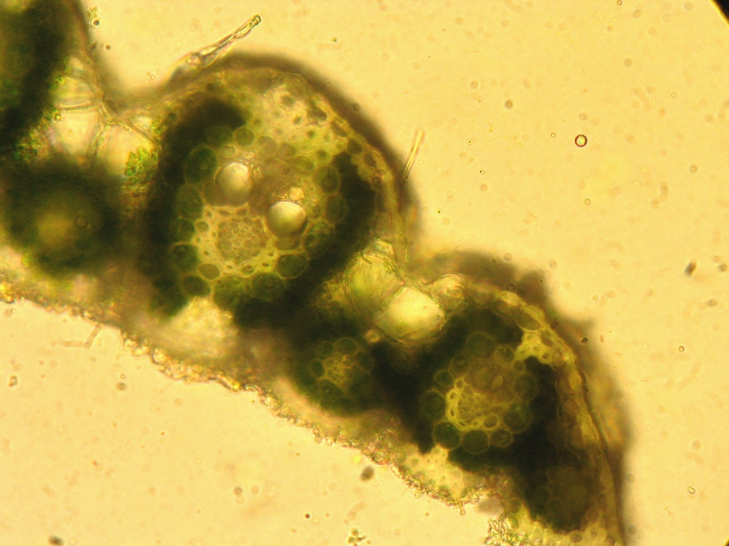
Anatomy of C₄-plants
bundle sheath cell
Xylem
mesophyll cell
S = starch
ZW = cell wall
LZ = bundle sheath cell
MZ = mesophyll cell
Phloem
Saccharum spontaneum
Notes:
The right picture shows a cross section of a leaf of Saccharum spontaneum, wild sugar cane. The vascular bundle with big xylem vessels and the phloem can be seen in the center of each „Kranz“, surrounde by the inner ring of big bundl sheath cells and the outer ring of darker green and smaller mesophyll cells.
The left photo shows to two chloroplasts in a bundle sheath cell (LZ, the upper chloroplast) and a neighbouring mesophyll cell (MZ), the lower chloroplast. There are two main differences between the chloroplasts in these two cell types: The upper bundle sheath chloroplasts contains big white starch granules. Starch is produced from glucose, if the production in the Calvin cycle exceeds the capacity of the phloem to transport it out of the leaf. So obviously, the Calvin cycle works in this chloroplast. Thylakoid membranes in this chloroplast are all lamellar thylakoids.
In the lower mesophyll chloroplast no starch granules can be found, the Calvin cycle does not seem to work in this chloroplast. Instead of that, you can see numerous dark granules in the chloroplast, these are granum thylakoids. Since the light reactions of photosynthesis take place in the granum thylakoids, obviously these chloroplasts are the place, where the light reactions take place. So just by seeing the microscopic pictrures of cross-sections, it ist obvious that in the C4-plant light reactions and Calvin cycle take place in anatomically different chloroplasts in different cells.
PSII mit O2-Bildung in Mesophyllzellen, in LZ hauptsächlich Calvin und zyklischer Elektronentransport

Slide 15
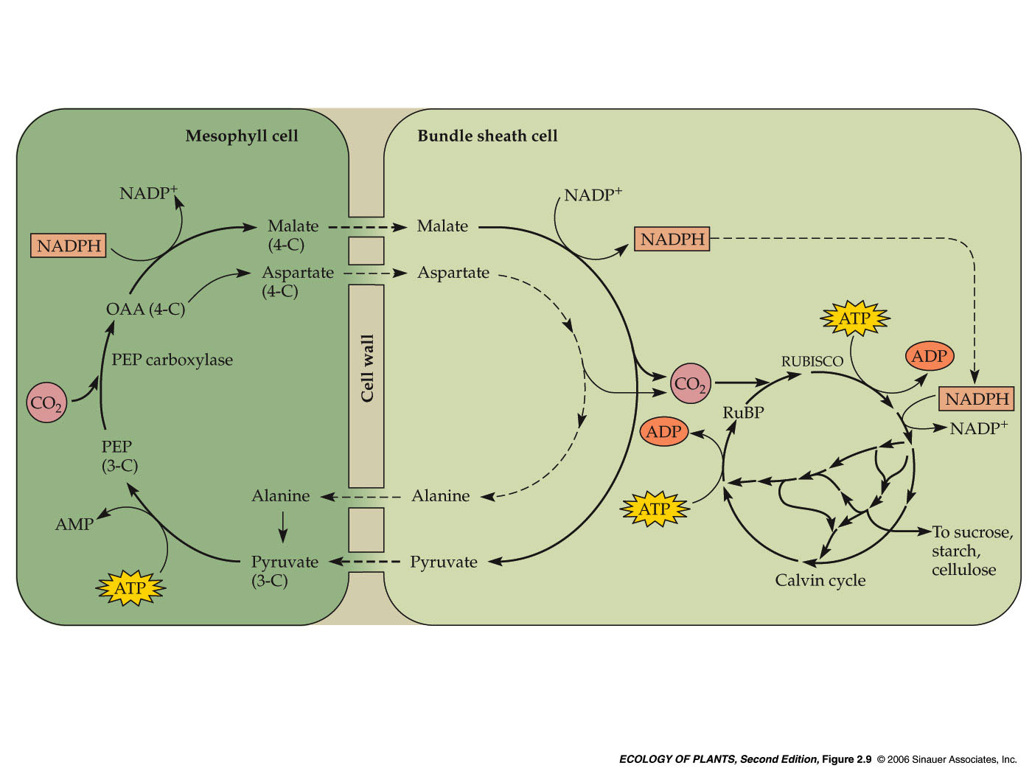
Mechanisms of C₄-photosynthesis
light reactions
an fixation of CO₂
Calvin-cycle
(reduction of CO₂)
Notes:
Here is what happens in these two different cell types: on the left, you see a dark green mesophyll cell, the outer ring of the „Kranz“, on the right a bundle sheath cell, the inner ring.
→ In the mesophyll cell, CO2 is bound to Phospho-enol-pyruvate – PEP- to form Oxalacetate (OAA), which is the reduced to Malate. The reaction of PEP with CO2 is catalysed by the enzyme PEP-carboxylase.
The Malate is then shuttled into the bundle sheath cell, where it is oxidised and the CO2 is split off again to form Pyruvate.
The CO2 is then fed into the Calvin cycle and processed by Rubisco. Electrons from NADPH, which have been transported with the malate as well, are used for the reduction steps of the cycle. There are other types of C4-plants which form aspartate instead of malate, but in principle the process is the same
→ The pyruvate has to be transported back into the mesophyll cell again to be phosphorylated using ATP to form PEP again.
The light reactions only take place in the mesophyll cell, in this way O2-evolution from the splitting of water only takes place in the mesophyll cell. In this way, Rubisco in the Calvin cycle is shielded from oxygen, so the Oxigenation-Reaction of this enzyme, resulting in photorespiration, is supressed.

Slide 16
Advantages of C₄-photosynthesis
High affinity of PEP-Carboxylase for CO₂ → more effective CO₂-uptake (low CO₂ -compensation) → stomatal pores can be closed to further extent
No oxygenase-activity of PEP-carboxylase → no photorespiration → lower CO₂ -compensation
One bundle sheath cell is fed CO₂ by many mesophyll cells → Rubisco works there in elevated CO₂ –concentration
no PS II and no oxygen evolution in the bundle sheath cells → no photorespiration
Very high rates of photosynthesis, no light saturation in normal circumstances, no photoinhibition

Slide 17
Disadvantages of C₄-photosynthesis
High demand of NADPH+H⁺ and ATP → high light demand
Costly transports of malate, pyruvate und NADPH+H⁺ between cells
Sensitive to cold

Slide 18
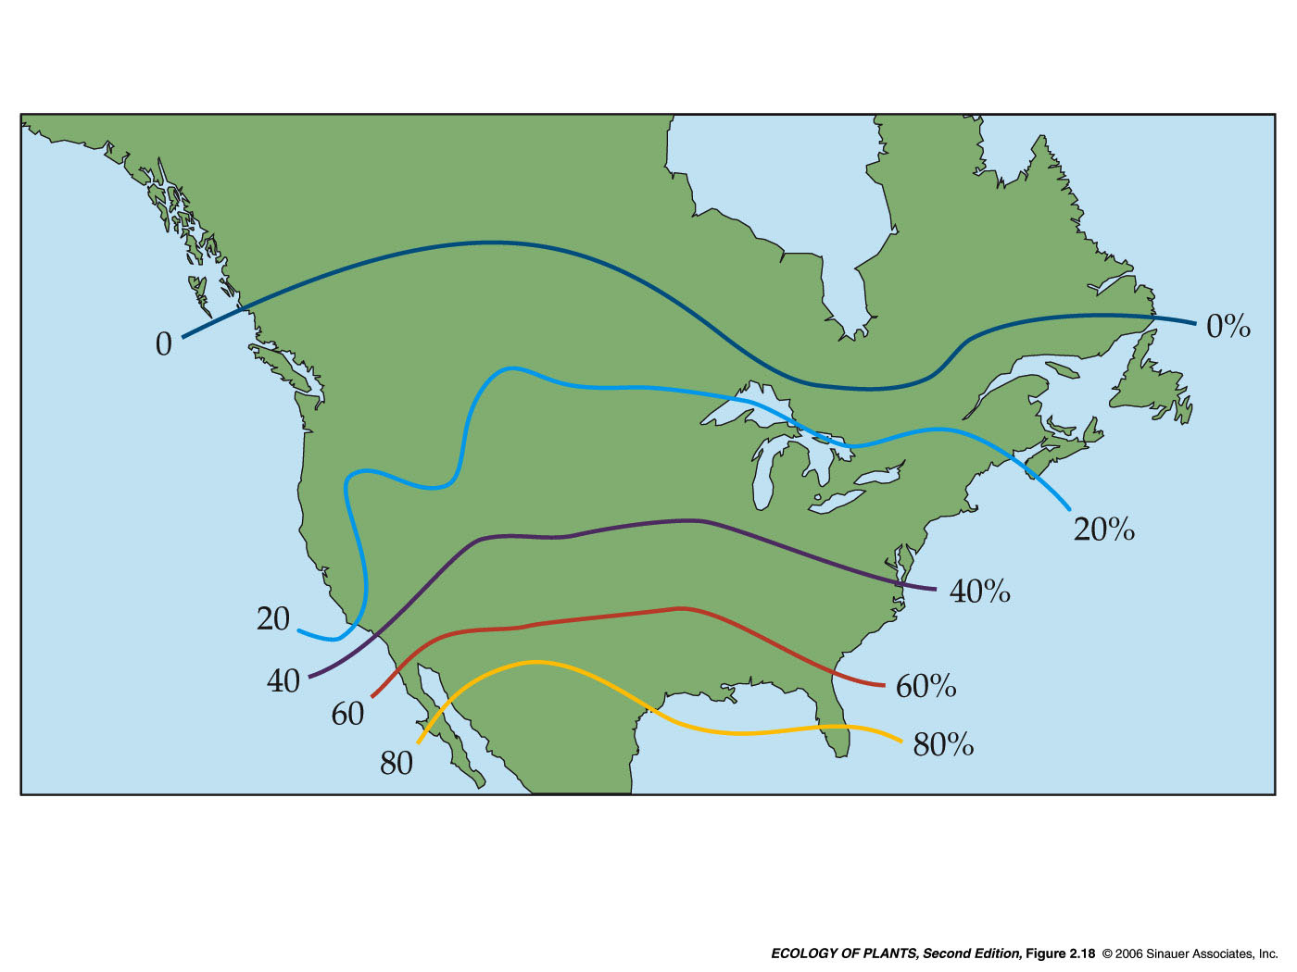
Change of percentage of C₄-grasses of all grass-species in Northern America with Latidude
Notes:
This map shows the increase of the percentage of C4-species of all grass species in Northern America with Latitude: while all grasses growing near the border to Canada a C3-species, further south the percentage of C4 plants increases, until about 80% of all grasses employ C4-metabolism near the border to middle America. This increase monitors an increase in temperature, irradiation and drought. High light intensities, warm temperatures and dry soils are the conditions C4-plants are best adapted to.

Slide 19
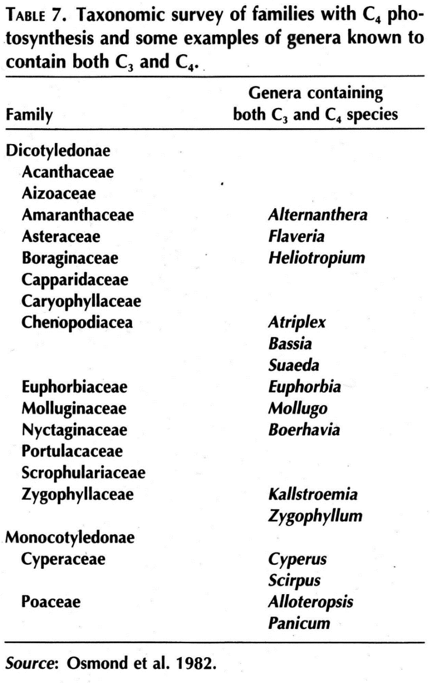
Families with C₄-species
Notes:
C4-metabolism seems to have evolved several times in different plant families, but it is most abundant in the grasses, the Poacea.

Slide 20
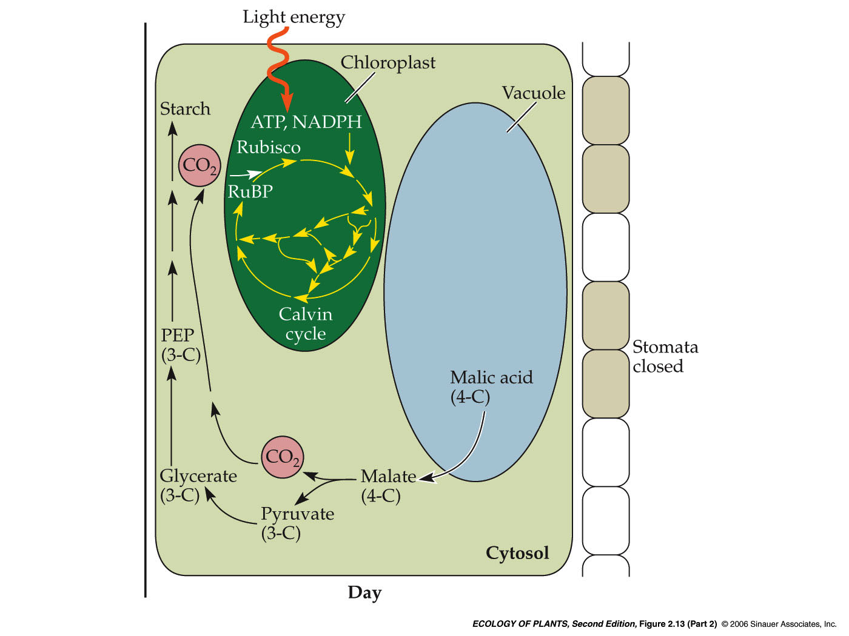
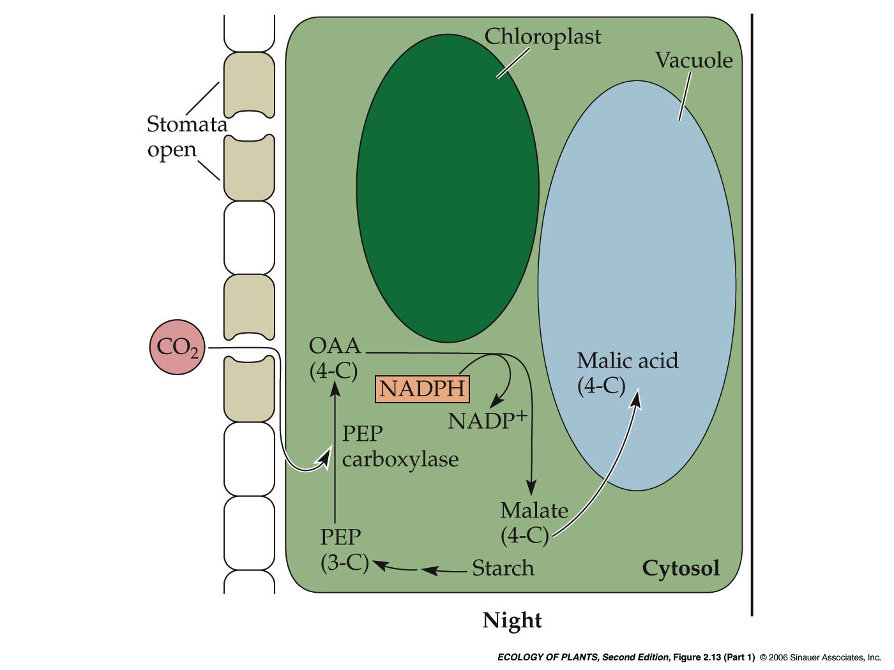
Crassulacean-Acid-Metabolism - CAM
night
day
Notes:
The crassulacean acid metabolism, CAM, employs the same chemical reactions as C4-metabolism. But where C4-plants use PEP-carboxylase to fix CO2 in the mesophyll cells and Rubiso in the bundle sheath cells to reduce CO2, CAM-plants differntiate between night and day.
→ During the night, shown on the left side, the stomatal pores of the plant are wide open, CO2 flows in and is bound to PEP by PEP-carboxylase to produce Malate. This malate is stored in the large cell-vacuoles. This happens during the whole night, PEP is supplied from starch all the time.
→ During the day, the stomatal pores are closed and no CO2 can flow into the leaf. Now the malate is transported from the vaculole into the cell again and de-carboxylised – CO2 is split off again. CO2 is then metabolised in the Calvin cycle in the Chloroplast. PEP is recycled from Pyruvate and stored in the form of starch.

Slide 21
Advantage of CAM
Extreme reduction of transpiration, since stomata are closed during the day
Disadvantage
Very low productivity

Slide 22
Characteristics of C3-, C4- and CAM-Photosynthesis
 | C3 | C4 | CAM
Leaf anatomy | typical, all chloroplasts with granum thylakoids | „Kranz“-anatomy, Bundle sheath cell chloroplast without granum thylakoids | Typical, large vacuole, all chloroplasts with granae
Primary product | 3-PGA (3-C) | Oxalacetate (4-C) | Oxalacetate (4-C)
PS-Depression by O₂ | Yes | No | Yes
CO₂-compensation | 30-50 ppm | <10 ppm | light: 0-200 ppm dark: <5 ppm
ATP/CO₂ | 3 | 5-6 | 3
Water consumption (g H₂O / g TG) | 610 | 300 | 33-240
Number of species | ~100.000 | 5.000 | 10.000

Slide 23
Break

Slide 24
Abiotic influences on photosynthesis
Notes:
This lecture is the first in a series on the environmental influences on photosynthesis. We ar going to start with responses to light.

Slide 25
Abiotic influences on photosynthesis
Several abiotic factors influence the rate of photsynthesis:
Light – driving force
CO2 – „raw material“
Temperature – operating temperature of enzymes, changes in sink-strengths
Water – influence on stomatal conductance
Nitrogen – component of photosynthetic apparatus
Notes:
Several abiotic factors exert influence on the rate of photosynthesis.
One major factor is obviously light – it is the driving force of photosynthesis
Another one is CO2, which provides the „raw material“
Temperature exerts ist influence mainly via the operating temperatures of the enzymes involved in photosynthetic reactions
Water provides electrons in the light reactions, but its main influence on photosynthesis is via its influence on stomatal conductance and with that on the supply of photosynthesis with CO2
Nitrogen and other nutrients influence photosynthesis, because they are components of the pigments that harvest the light and the enzymes, which catalyse the reactions in photosynthesis.

Slide 26
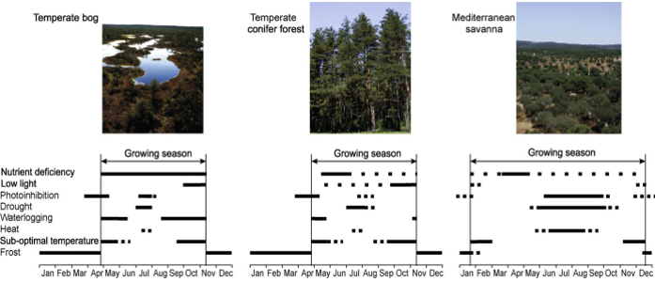
Frequent combination of stresses in 3 contrasting ecosystems
severe and frequent stress mild or sporadic stress
Responses of forest trees to multiple stresses 2010 U. Niinemets Forest Ecology and Management 260, 1623-1639
Notes:
The examination of the influences of single factors and stresses on plant performance is usually only possible in artificial settings. In natural settings, factors are often coupled – for example high light intensities, which often occur in combination with higher temperatures and, following that, lower humidity of the air. In high elevations and at the top leaves of trees you can add high wind speeds to the list. Responses of the plants are rarely caused by one factor alone and acclimation and adaptation must cover several factors.
This is a generalized illustration of the occurence of stress in 3 contrasting Northern Hemispere ecosystems. Plants mainly sustain stress during the growing period and are less susceptible to stress during the winter frost period when they are often dormant.
The importance of various stress factors varies throoghout the growing season in each ecosystem in a characteristic manner.
→ For example, plants in a temerate bog may experience stresses from low temperature, waterlogging and low light intensities ind spring and autumn, while being exposed to drought and photoinhibition caused by high light intensities during mid-summer. They have to cope with nutrient-deficient soils all year round.
→ On the other side of the spectrum, plants in mediterranean savannas experience stress from drought, heat and photoinhibition from late spring to early autumn.
→ Even temperate forests in less extreme habitats rarely experience just one stressor at a time, they have to adjust to a combination of low light intensities, cold and waterlogging in spring and autumn and, in times of accelerating global change to ever increasing severities of drought, heat and photoinhibition.

Slide 27
Abiotic influences on photosynthesis
Several abiotic factors influence the rate of photsynthesis:
Light – driving force
Water – influence on stomatal conductance
CO2 – „raw material“
Temperature – operating temperature of enzymes, changes in sink-strengths
Notes:
Several abiotic factors exert influence on the rate of photosynthesis.
One major factor is obviously light – it is the driving force of photosynthesis
Another one is CO2, which provides the „raw material“
Temperature exerts ist influence mainly via the operating temperatures of the enzymes involved in photosynthetic reactions
Water provides electrons in the light reactions, but its main influence on photosynthesis is via its influence on stomatal conductance and with that on the supply of photosynthesis with CO2
Nitrogen and other nutrients influence photosynthesis, because they are components of the pigments that harvest the light and the enzymes, which catalyse the reactions in photosynthesis.

Slide 28
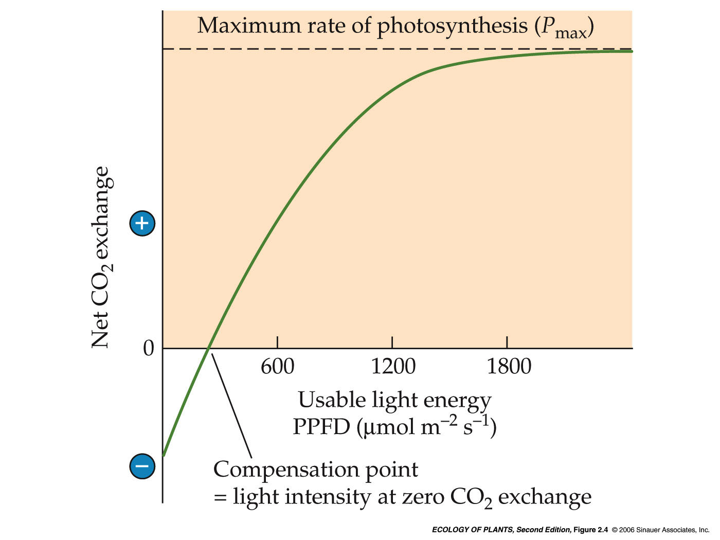
Light-effect-curve of a typical C₃-plant
maximum rate of net photosynthesis (A_{max})
90% of (A_{max})
limited by light
intensity
limited by
carboxylation
capacity
Net CO₂ uptake (ymol m⁻²s⁻¹)
Photosynthetically active radiation PAR
dark respiration
Light compensation
= light intensity at zero gasexchange
Light saturation
Notes:
The light-effect-curve starts a zero light with a neagative CO2-uptake, that is an emission of CO2 from the leaves.
Photosynthesis is zero at this point, the value of CO2-emission gives you the rate of dark respiration of the leaf. With increasing photon flux density, the curve initially increases linearly, before it starts to flatten to eventually reach a plateau
The point, where the curve intersects the x-axis shows the photon flux density, where CO2-uptake by photosynthesis and CO2-loss by respiration are balanced – it is called light compensation point and is an important parameter to differentiate between shade- and sun-adapted plants.
The value of the plateau gives you the highest rate of photosynthesis Amax of the plant – also a parameter to differentiate between plants adapted to different light conditions.
Light saturation is defined as the photon flux density where 90% of Amax are reached.
As long as the curve increases, the main limiting factor of photosynthesis is light intensity. Each increase in photon flux densitiy inreases the rate of photosynthesis. With light saturation, other factors dominate limitation: the availability of CO2 (limited by concentration in the air and stomatal conductance), the amount of Calvin cycle enzymes in the chloroplast or the number of photosystems in the thylakoids, all of which limit the carboxylation capacity of photosynthesis.

Slide 29
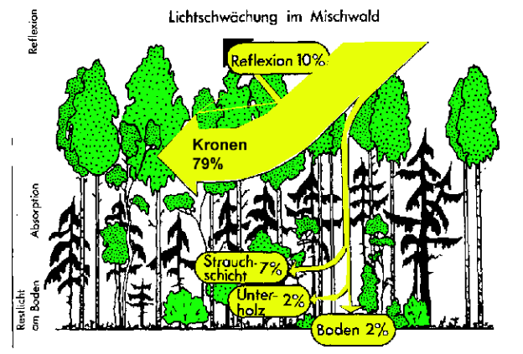
Decrease of light intensity within the forest canopy in temperate mixed forest
2.000 ymol m⁻² s⁻¹
Verändert nach
Nachtigall & Werner 1985
40 ymol m⁻² s⁻¹
Notes:
Light intensity a major factor defining the habitat of a plant. For example in a European mixted forest, the leaves in the sun crowns of the dominant trees receive 25 times the number of photons of the herbs and saplings at the forest floor.
On a bright day PAR at the top of the forest is about 2.000 ymols of photons per sqm and second. Of these 2000 ymols, only about 140 reach the Shrub layer, only 40 the Herb layer.
Plants growing in the Herb layer of such a forest can either adapt to these low light intensities, or they can avoid them – that is what for example many geophytes do, which blossom and complete their life cycle before the decidious trees come into leaf.

Slide 30
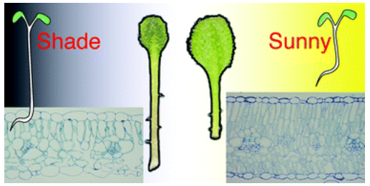
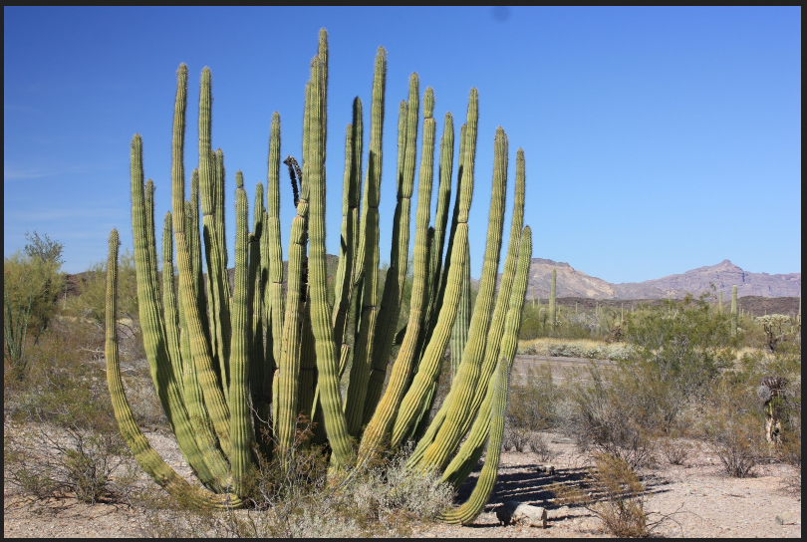
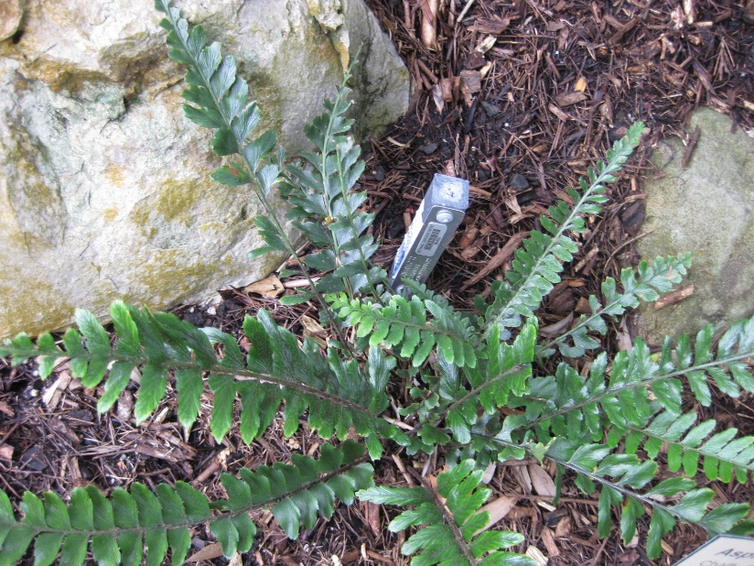
Acclimation and Adaptation
Sun and shade leaves of Arabidopsis thaliana
Stenocereus thurberi
Asplenium paleaceum
Acclimation = individual adjustments to environmental variation within
genetic constraints
Phenotypic plasticity
Adaptation = evolutionary adjustment to regular growth conditions
→ Genetically manifested
Notes:
Adjustment to differet light environments can take place on different levels: leaves of different parts of one plant can be acclimatized to the different light regimes, for example in the sun- and shade crown of a tree.
Herbacious plants of one species growing in different habitats can adjust to light intensities underneath a dense canopy or near the edge of the forest.
These acclimations are individual responses to environmental variation within the genetic constraints of the species. They show the phenotypic plasticity of the individual plant.
On the next level, species are especially adapted to the habitat they usually grow in, these adaptations are genetically manifested.

Slide 31
Light-effect-curve of a typical C₃-plant
limited by light
intensity
limited by
carboxylation
capacity
Net CO₂ uptake (ymol m⁻²s⁻¹)
Photosynthetically active radiation PAR
Notes:
As the light curve shows, acclimation and adaptation to high-irradiance einvironments should enhance carboxylation capacity to enable the leaf or plant to use the available light to its full extent.
On the other hand, plants grown in darker environments are probably more limited by photon flux densitiy than by carboxylation capacity. Here the response should enable the leaves to harvest as many of the precious few photons as possible.

Slide 32
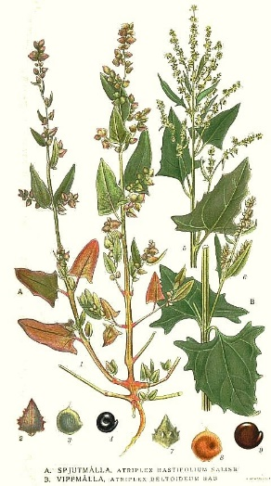
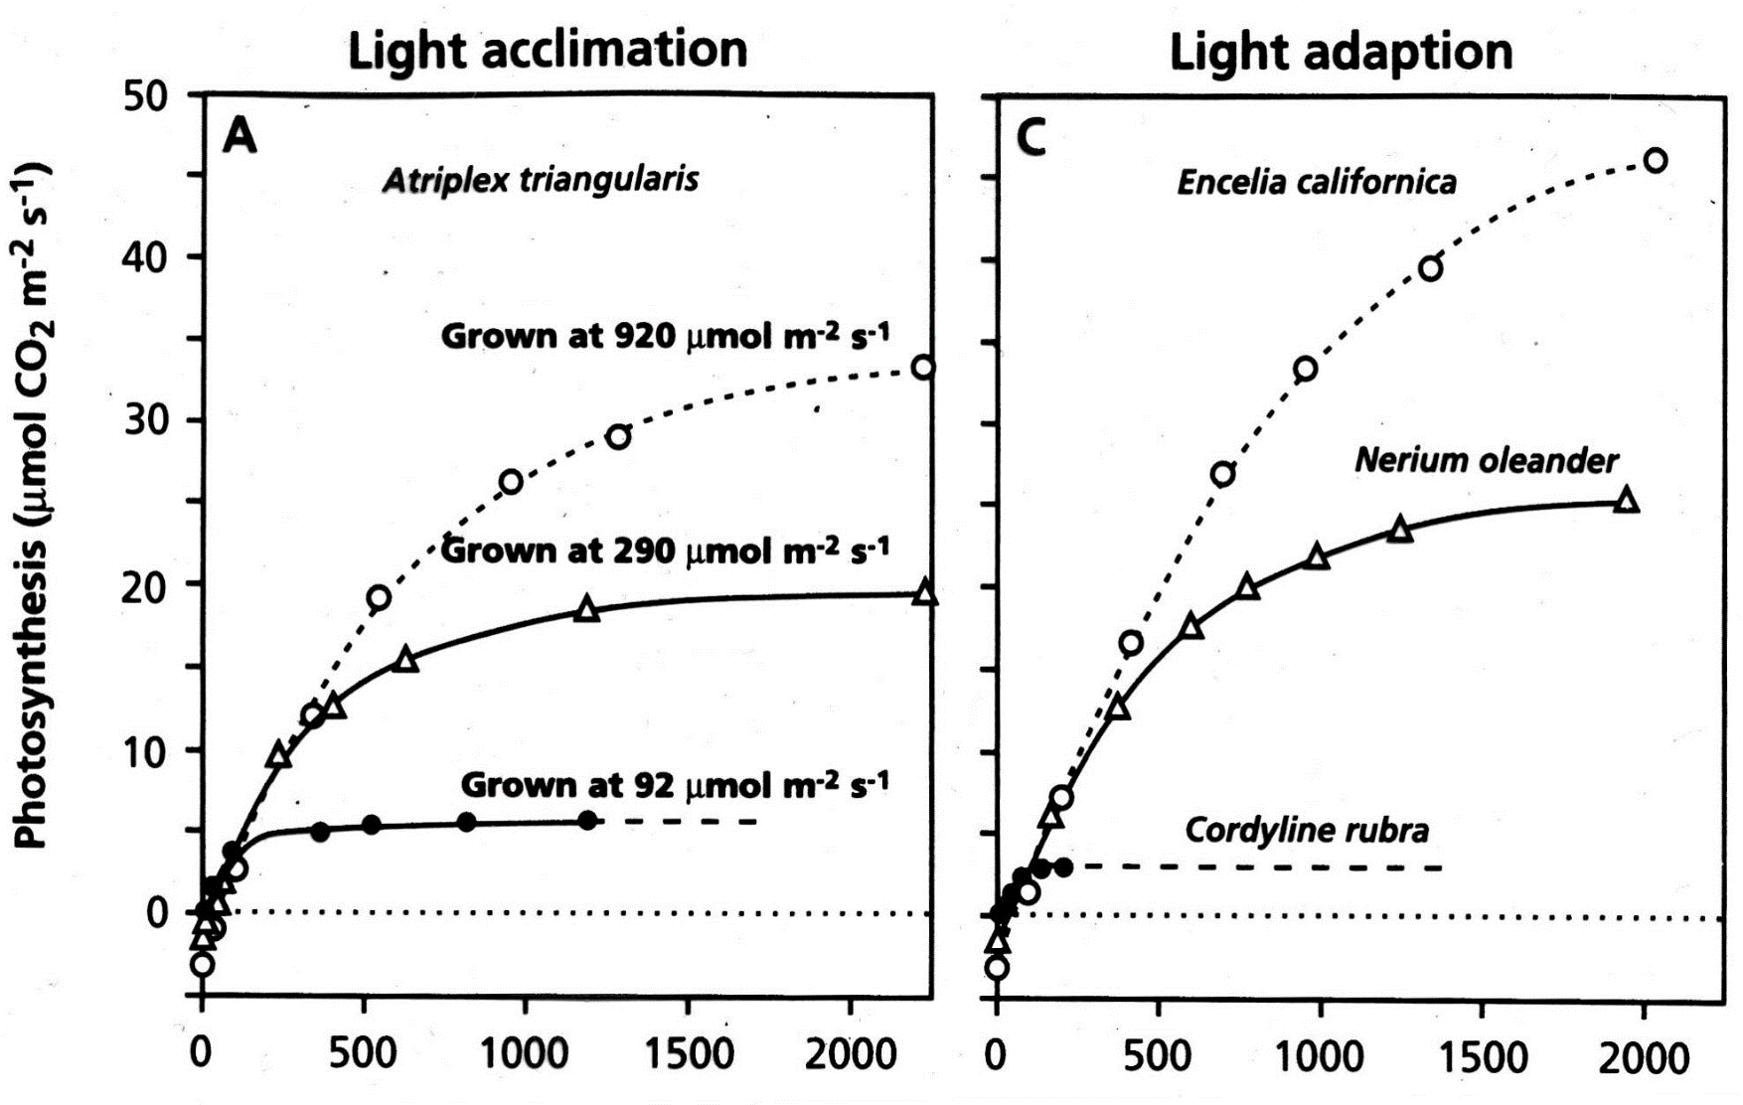
Light acclimation = individual adjustment of the organism within its
genetic constraints
Atriplex prostrata
subsp. triangularis
Notes:
Atriplex prostrata, in German Spieß-Melde, in English halberd leaved Orach, ist an annual plant native in Europe and Central Asia. It grows in salt marshes and other open saline habitats, so it is genetically a sun adapted plant.
This diagram shows the light effect curves of 3 plants, which have been grown in different light conditions, either in very low light intensity (92ymol photonen per sqm and second, black dots), medium light intensity 290 ymol sqm s (open triangles) or high light intensitiy with a photon flux density of 920 ymol sqm s (open circles).
It is obvious, the higher the light intensity at the cultivation of the plants, the higher the maximum photosynthesis Amax reached in this experiment. Shade grown plants were limited by carboxylation capacity at much lower light intensities than those grown in high light conditions. Those plants grown at 920 ymol photons sqm s were able to use higher photon flux densities effectively to yield higher carbon gains in photosynthesis.
Atriplex – Spieß-Melde – Europaweit bis Zentralasien, Salzpflanzenfluren bis Ruderal
Cordyline rubra – Palm-Lilie, Boden warmer Regenwälder und feuchter Eucalyptuswälder Australiens
Nerium oleander – mediterrane Auenpflanze
Encelia californica – Californian Brittlebush – niedriger Busch, Kalifornien, Chaparral (buschige Küstenvegetation)

Slide 33
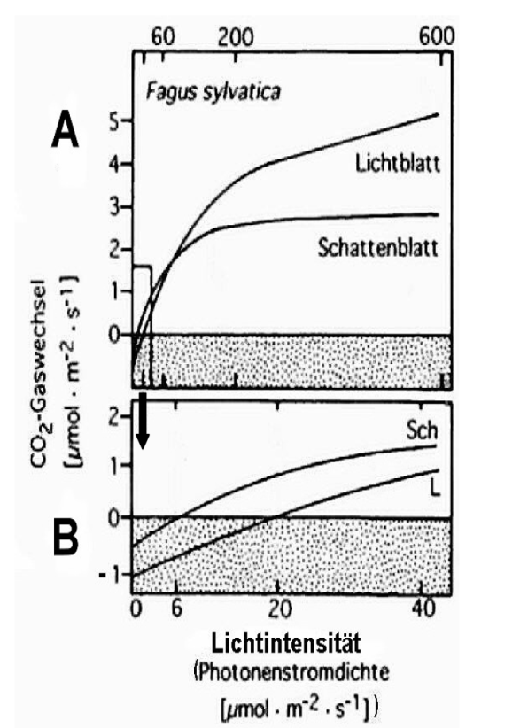
Light effect curves of sun and shade leaves of European Beech (Fagus sylvatica)
Amax
Light compensation point
Notes:
In Graph A you see, that while the shade leaves already reach Amax at light intensities around 200ymol photons sqm sec, the sun leaves have not yet reached Amax at more than 600 ymol sqm sec. The sun leaves reach much higher rates of photosynthesis than the shade leaves in high light, they are able to efficiently use high light intensities.
Graph B focuses on the response of the leaves to low light intensities: while the shade leaves reaches light compensation at about 6 ymols photons per sqm and second , the sun leaves needs at least 20 ymols of photons to compensate for the CO2-loss of respiration. The shade leaves achieve a net gain of photosynthesis at much lower light intensities than the sun leaves. Keeping in mind, that light intensitiy at the forest floor is only 2% of that at the top canopy, the shade leaves are well adapted to generate surplus glucose even in very low PAR. Sun leaves, on the other hand, are barely able to generate profit in this low PAR, especially if you bear in mind, that photosynthesis can happen only during the light hours of day, while dark respiration is neccessary all around the clock.

Slide 34
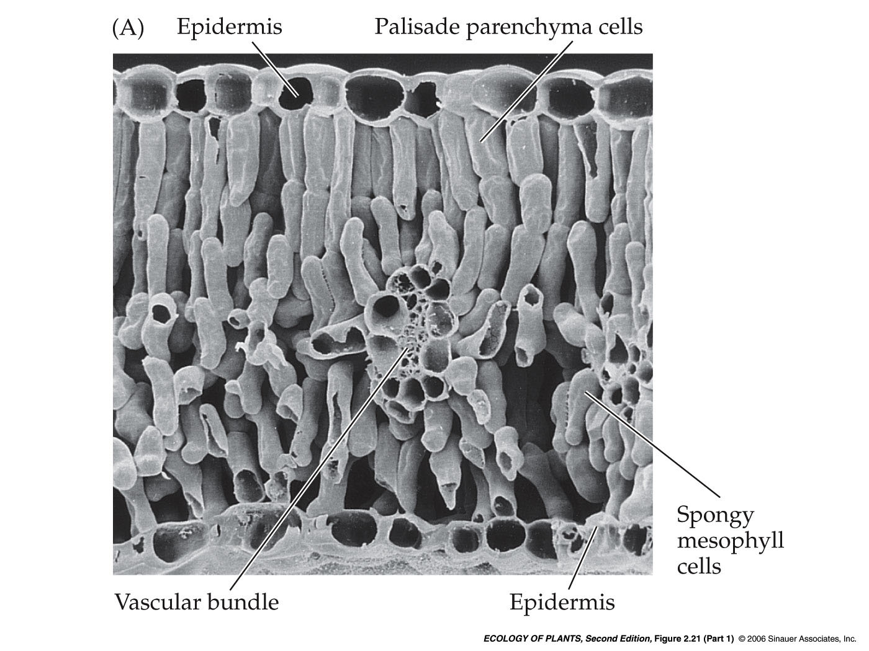
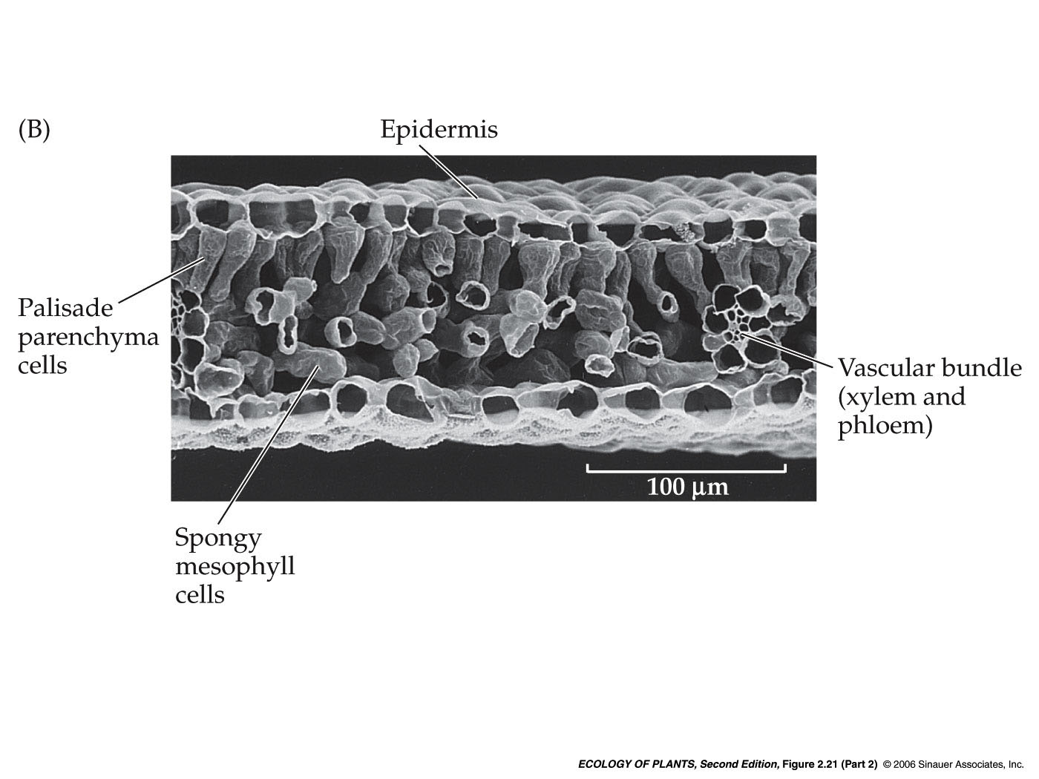
Anatomy of sun- and shadeleafs of European Beech
Sunleaf
Shadeleaf
Epidermis
Palisade-
mesophyll
Epidermis
Spongy
mesophyll
Vacular bundle
Vascular bundle
Epidermis
Notes:
The anatomical background of the adaptations to different light regimes can be seen in these cross-sections of sun- and shadeleaves of European Beech.
Both show the typical broad-leaf anatomy:
an upper epidermis,
chloroplast-rich Palisade mesophyll underneath,
then the spongy mesophyll permeated by the vascular bundles
and the lower Epidermis with the Stomata.
The double layer palisade mesophyll and the thicker spongy mesophyll give the sun leaf more chloroplasts per area to enhance their photosynthetic capacity – they have all the light reactions and Calvin cycle enzymes they need to effectively use great amounts of photons.
These larger numbers of cells per leaf area are the reason for the higher dark respiration rates per area the sun leaves exhibit, and with that for the higher light compensation points. These many cells per leaf area need higher amounts of energy than the fewer ones in the thin shade leaves.

Slide 35
Anatomy of sun- and shadeleafs of European Beech
 | Sunleaf | Shadeleaf
Leaf thickness (µm) | 185 ± 12 | 93 ± 5
Leaf area (cm²) | 29 ± 4 | 49 ± 7
Stomatal density (stomata /mm²) | 214 ± 26 | 144 ± 11
Water content (% fresh weight) | 53 ± 4 | 70 ± 5
A_{max}
Light saturation
Dark respiration
Light compensation
Quelle: Lichtenthaler et al. 1981, verändert nach Gurevitch et al. 2006
Notes:
The anatomic difference between sun and shade leaves of Beech are summarized in this table.
Sun leaves, as seen in the cross section before, are about twice as thick as shade leaves
On the other hand, they are much smaller, only about 29 sqcm as compared to the 49 sqcm of shade leaves
Sun leaves process much higher amounts of CO2 than shade leaves and have smaller overall leaf areas, so they need much more stomata per area to get the CO2 into the leaf- their stomatal density is much higher.
The water content of sun leaves is lower than that of shade leaves: Sun leaves are exposed not only to light, but with that to heat and wind as well, both of which increase transpiration and the cuticular permeability to water. To minimize cuticular permeance, cuticles in sun leaves are thicker than those in shade leaves. Sun leaves are generally tougher than shade leaves, containing more structural material like cellulose and lignin.
Amax reached by sun leaves is much higher than that reached by shade leaves – they have more cells, more chlorophyll, more Photosystems, more Calvin Cycle enzymes than schade leaves, so they can reach higher rates of photosynthesis.
Since sun leaves have have more cells, more chlorophyll, more Photosystems, more Calvin Cycle enzymes than shade leaves, they need more energy to maintain them
Which translates to higher dark respiration rates and, following that, higher light compensation points.

Slide 36
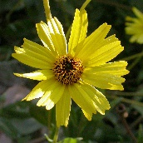
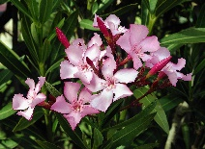
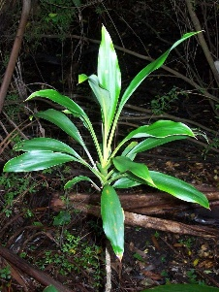
Light adaptation = genetic adaptation to light environment on species level
CO₂-uptake (ymol m⁻² s⁻¹)
PPFD (ymol m⁻² s⁻¹)
Notes:
Within its genetic possibilities an individual plants can acclimate to different light conditions, it can express its phenotypic plasticity.
If a species evolves adaptations to a specific light environment, it is genetically adapted to this environment.
This graph shows the light-reaction curves of C3-plant species from 3 different habitats. Cordyline rubra on the lowermost picture and with the lowermost curve is a palm lily growing in the understorey of warm rainforests and moist Eucalypt-forests in Australia. It shows the typical light-effect curve of a shade plant with early light saturation and low Amax.
Nerium oleander on the middle picture is a mediterranean shrub naturally occuring along river banks – this species is adapted to higher light intensities, as the curve shows.
The topmost picture shows Encelia californica, the Californian Brittlebush, a low bush growing in the Chaparral along the Californian coast. It is adapted to high light intensities, as the high light saturation and Amax show.
All of these species are able to acclimate to some extents to variable light intensities, but Encelia californica will always show the characteristics of a sun plant and Cordyline rubra that of a shade plant due to their genetic makeup.
Cordyline rubra – Palm-Lilie, Boden warmer Regenwälder und feuchter Eucalyptuswälder Australiens
Nerium oleander – mediterrane Auenpflanze
Encelia californica – Californian Brittlebush – niedriger Busch, Kalifornien, Chaparral (buschige Küstenvegetation)

Slide 37
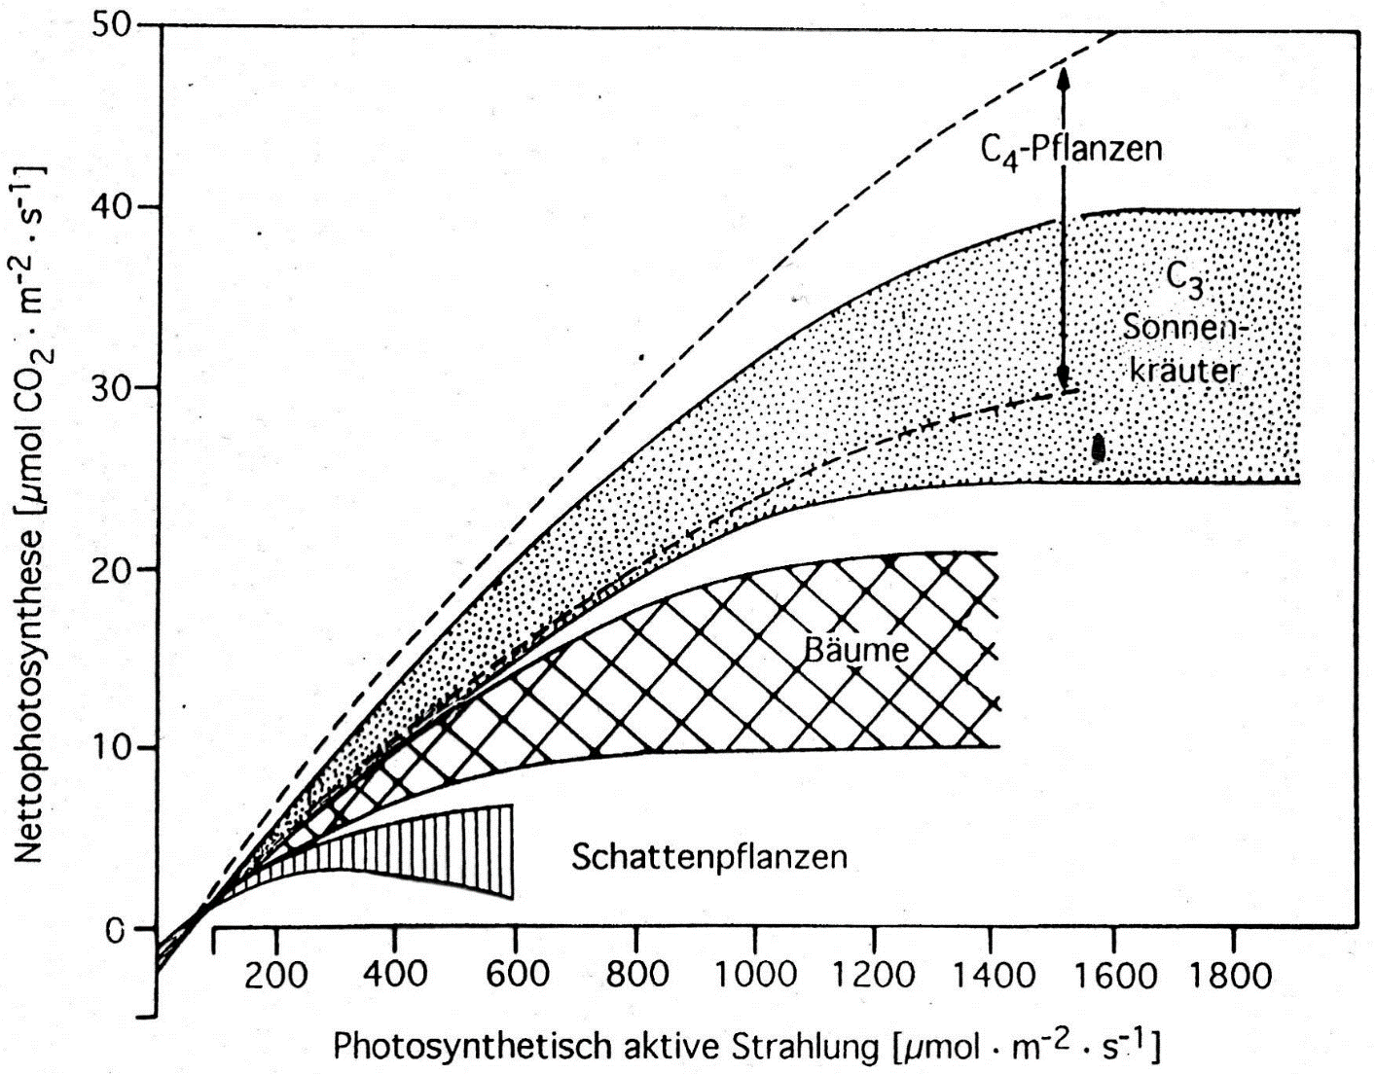
Light curves of plants from different light environments
C₄-plants
C₃ sun
herbs
Trees
Shade plants
Photoinhibition, photooxidation
Notes:
Here you see the broad range of Amax of plants from different habitats: Shade plants show very low maximum rates of photosynthesis, they may even be harmed by high light intensities.
Herbacious sun plants reach much higher Amax and reach light saturation at higher light intensities. Trees fall in between sun herbs and shade plants. This is mainly due to adaptations to a long life and a rather conservative handling of ressources.
C4 plants show the most high-light adapted curves – they reach light saturation only at very high light intensitiies, meaning they are able to use increases in photon flux density very effectively to increase net photonsynthesis. Their disadvantage is their very high rate of dark respiration, which restricts their survival to high light environments.

Slide 38
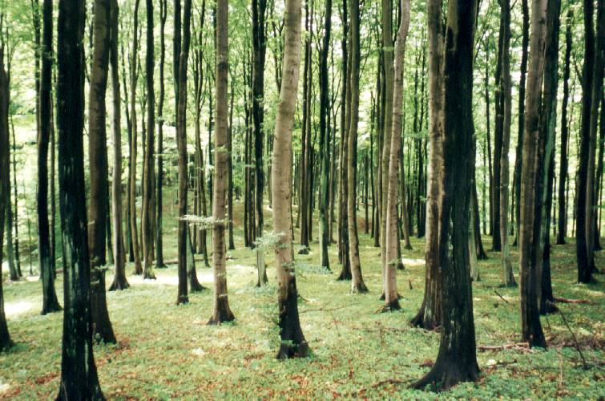
Fast responses to short sunflecks
20-80% of daily photons
in understorey habitats
from sunflecks
Sunflecks are major
source of energy for
shotosynthesis in these
habitats.
30-60% of daily carbon
gain in tropical forest
understoreys
(Way & Pearcy 2012)
Notes:
Apart from long and very-long term acclimation and adaptation, individual plants can show very fast responses to light as well. This enables them to harvest and use high but short-lived sources of light in an otherwise shady environment.
Sunflecks are beams of light that pass through gaps in the canopy and only reach the ground for seconds to minutes.
→ Direct measurements of of the light environmet and gas exchange in various forests show that, depending on the canopy structure, 20 to 80% of the total daily photon flux density (PFD) that reaches understorey plants is from sunflecks.
→ For the understorey-plants growing in the shade of the canopy these short intervalls of high photon-flux-densitiy can be a major source of energy for photosynthesis - Sunfleck utilization can contribute between 30 and 60% of the daily carbon gain in tropical forest understories.

Slide 39
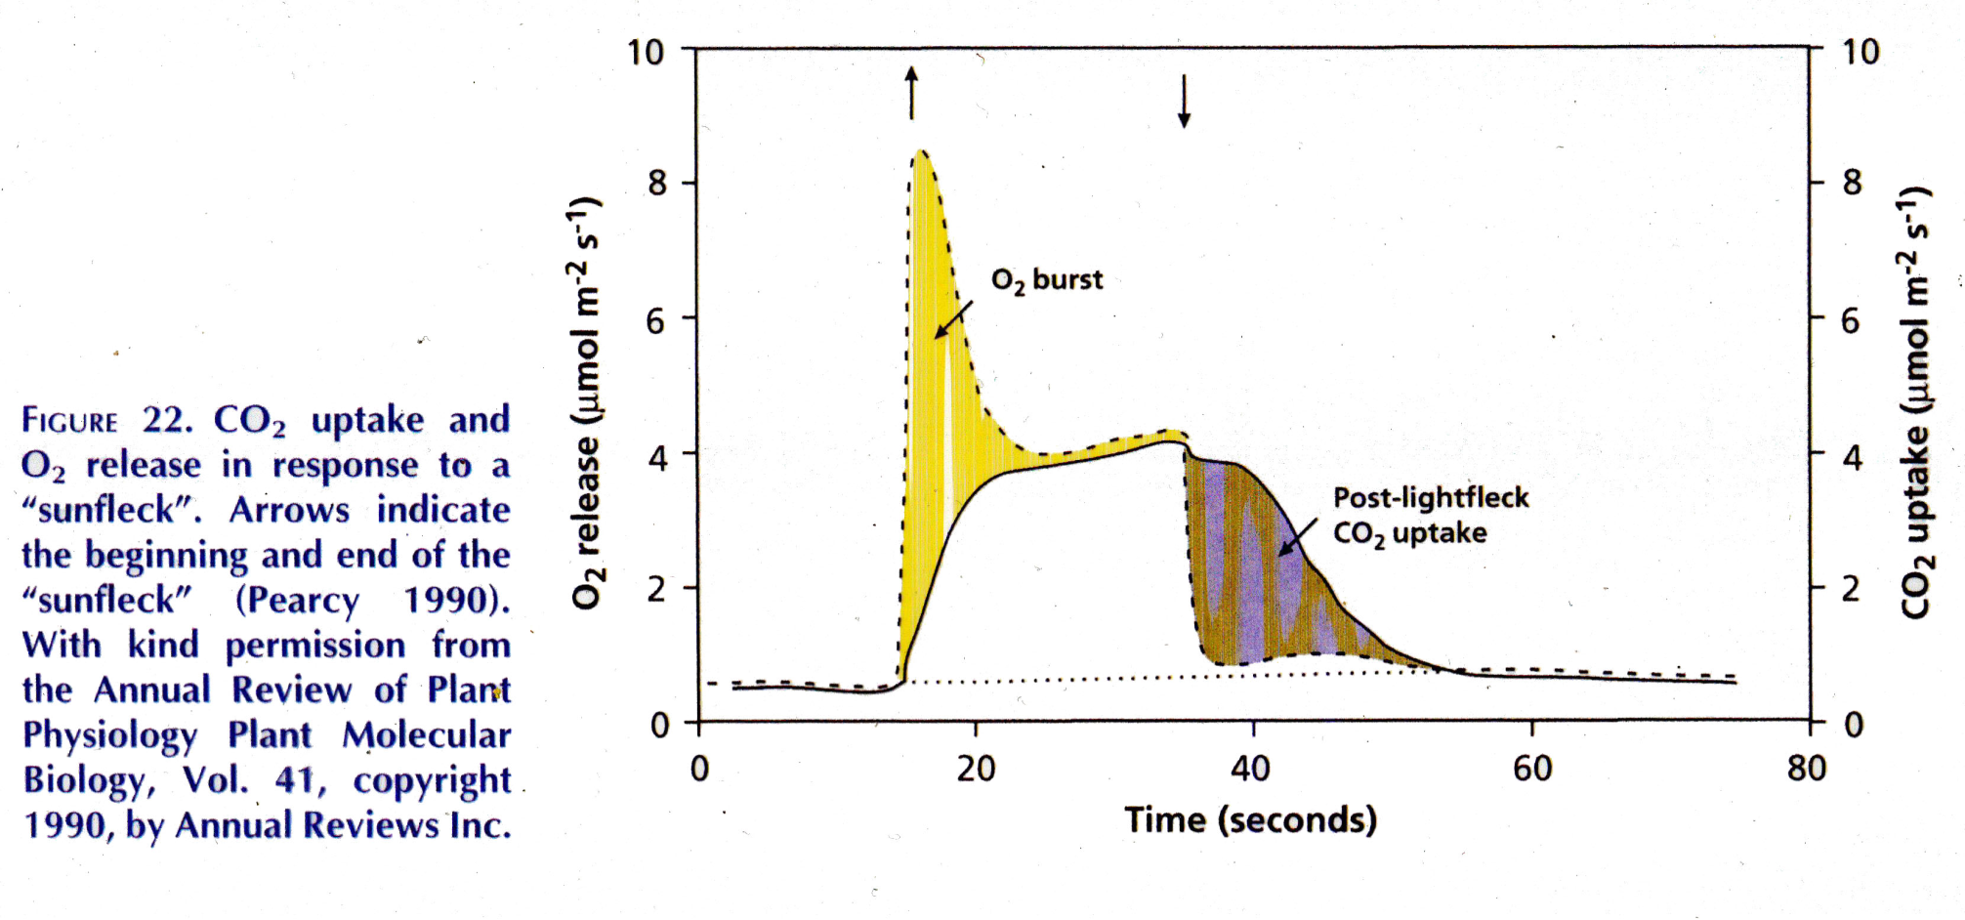
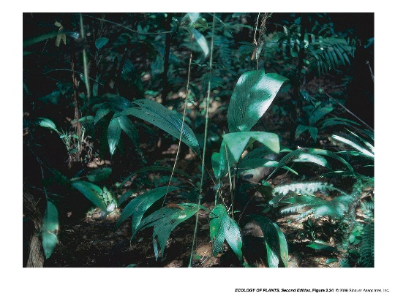
Fast reaction to short sunflecks
Alocasia macrorrhiza
Notes:
This graph shows the release of Oxygen from the light reactions of photosynthesis and the CO2-uptake in the Calvin cycle of Alocasia macrorrhiza, the Giant Taro. This plant is native to the understorey of rainforests in Island South Asia, New Guinea and Queensland. The X-axis of the graph shows the time around a short impuls of high light intensity, its onset and end indicated by the red arrows. The left Y-axis shows the O2-release from the leave in ymol per sqm and second, the right Y-axis the CO2-uptake, also in ymol per sqm and sec.
Right after the beginning of the simulated light fleck, the O2-evolution rises steeply and peaks just seconds later. O2-release exceeds CO2-assimitlation at the beginning of the sunfleck (yellow filled curve), which shows that Light harvesting and energy transfer react instantaneously to high PFD, as does the electron transport This leads to a rapid build-up of a Ribulose 1,5 bisphosphate –pool.
After the activation of enzymes in the Calvin cycle, CO2- assimilation and electrontransport are coupled and O2-release and CO2-uptake match.
After the sunfleck passed, CO2-assimilation can go on for a few seconds using the pool metabolites filled at the beginning (Way & Pearcy 2012)
In this way, sunfleck utilization can contribute between 30 and 60% of the daily carbon gain in tropical forest understories.

Slide 40
Abiotic influences on photosynthesis
Several abiotic factors influence the rate of photsynthesis:
Light – driving force
Water – influence on stomatal conductance
CO2 – „raw material“
Temperature – operating temperature of enzymes, changes in sink-strengths
Notes:
Several abiotic factors exert influence on the rate of photosynthesis.
One major factor is obviously light – it is the driving force of photosynthesis
Another one is CO2, which provides the „raw material“
Temperature exerts ist influence mainly via the operating temperatures of the enzymes involved in photosynthetic reactions
Water provides electrons in the light reactions, but its main influence on photosynthesis is via its influence on stomatal conductance and with that on the supply of photosynthesis with CO2
Nitrogen and other nutrients influence photosynthesis, because they are components of the pigments that harvest the light and the enzymes, which catalyse the reactions in photosynthesis.

Slide 41
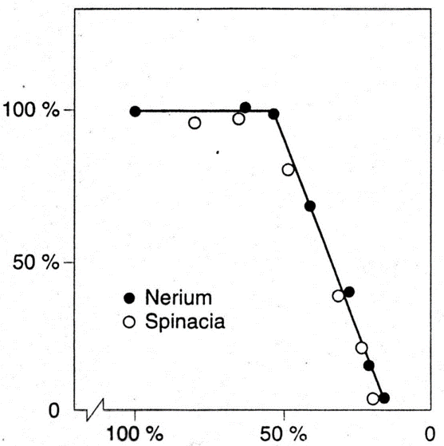
Limitation of photosynthesis by water-shortage
Response of relative rate of photosynthesis
to contiued drying up of leaf-discs (modified from
Larcher, 2001)
Relative rate of photosynthesis (%)
Oleander
Spinach
Relative volume of protoplast
Notes:
Water shortage can directly affect all processes in the cell, including photosynthesis and respiration. This graph shows the reduction of relative rate of photosynthesis (as percentage of the maximum rate) with increasing dessication of a disc cut from a leaf. The experiment was conducted on leaf discs instead of whole leaves to eliminate the influence of stomatal responses.
Both spinach and oleander leaves respond in more or less the same way. Photosynthesis is largely unaffected by relative volume-loss of the protoplast up to about 45%. With further loss of water, photosynthesis deteriorates dramatically.
Plants try to prevent water losses of this magnitude, since they are usually fatal, so this direct effect of water shortage on photosynthesis is rarely examined in natural settings.

Slide 42
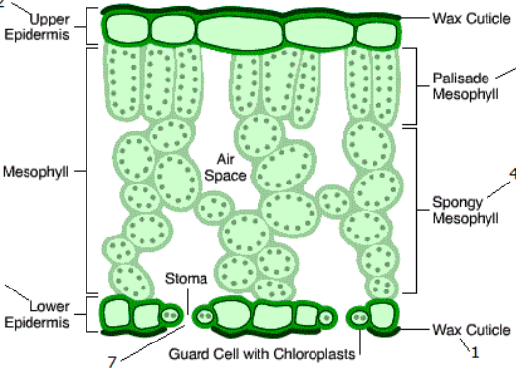
Stomata and their role in photosynthesis
stomata
„gatekeepers“ for all gaseous diffusion between leaf and outside air
maximize CO₂-uptake
minimize H₂O-loss
respond to light, vapour-pressure deficit, Ci, information (hormones, xylem-pressure) about water status from different parts of the plant)
CO₂-diffusion
H₂O transpiration
Notes:
To prevent uncontrolled water loss from the leaves, they are covered by the cuticle and the stomatal pores act as gatekeepers for the gas exchange processes of the leaf. In order for the plant to function efficiently, they have to balance gas exchange in a way that maximizes CO₂-supply to photosynthesis, while minimizing water loss.
To do this, stomata respond to environmental information like Water vapour concentration in the air and light, and to internal information concerning the water-status of the plant and of the soil.
It depends on the water-status of the plant, whether precedence is given to maintaining high rates of photosynthesis by maximizing CO₂-uptake, or to reducing transpiration by closing the stomata.

Slide 43
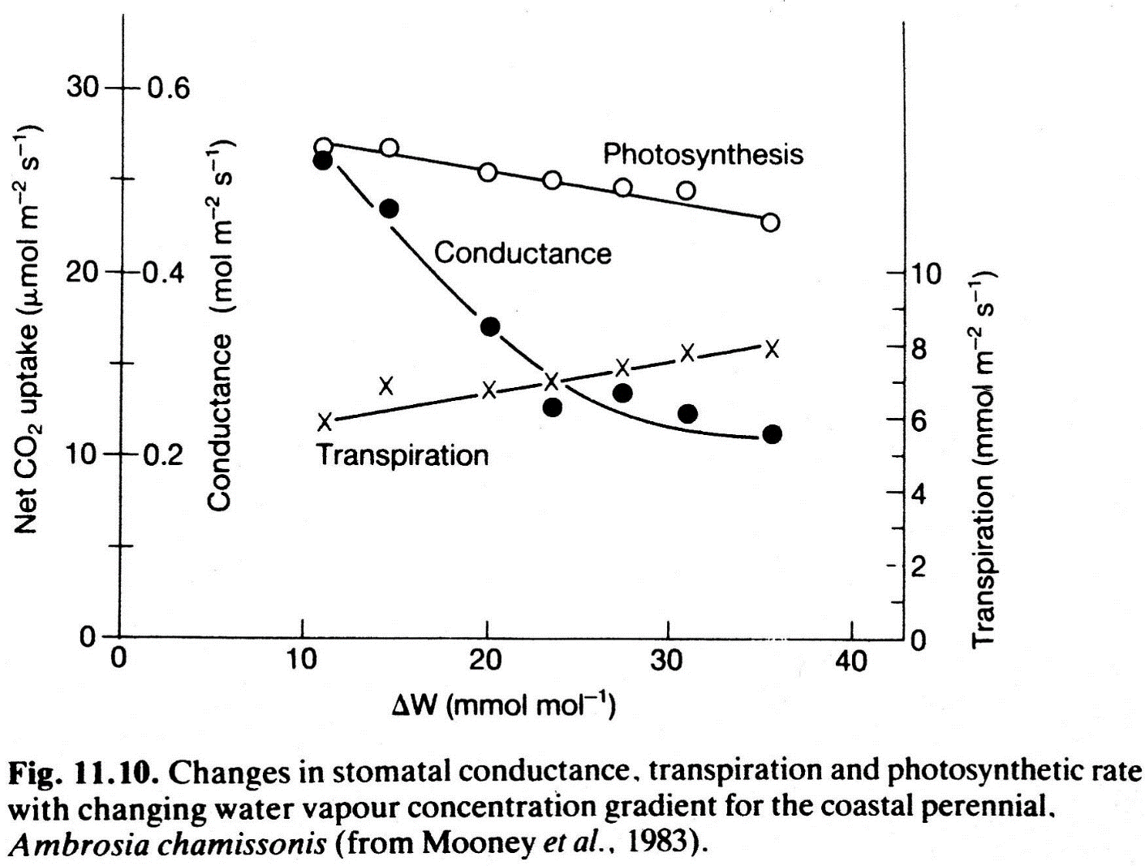
Stomata and their role in photosynthesis
Stomata respond very early and
sensitive to Water vapour deficit
Stomatal Closure affects Transpiration nore than photosynthesis
Water-Use-Efficiency WUE
fixed CO₂ / transpired H₂O
rises
Notes:
This graph shows you the responses of stomatal conductance, transpiration and photsynthesis to an increasing water concentration gradient between leaf and outside air. This gradient, which can be expressed as a vapour pressure deficit as well, is the driving force of transipiration from the leaf. As soon as this gradient increases, the stomata close to counteract the increase in transpiration.
The extent of the stomatal reaction depends on the water-stress the plant experiences – a droughted plant will respond faster and reduce conductance further than a well-watered one. Timing and extent of stomatal response also differ between plants applying rather conservative and others using rather prodigal strategies of exploitation of resources.
Reduced stomatal conductance affects transpiration more than the influx of CO₂, the efflux of H₂O is reduced by a higher percenctage than the influx of CO₂ . This increases the Water-Use-Efficiency WUE of photosynthesis, the amount of CO₂ fixed per H₂O lost in transpiration.

Slide 44
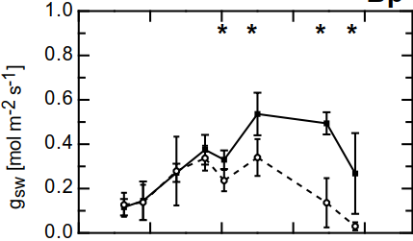
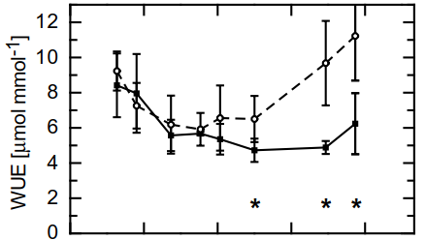
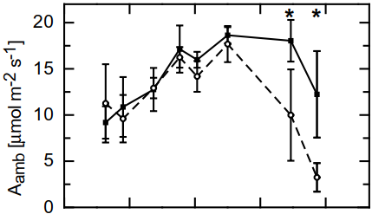
Stomatal conductance
Influence of water shortage on stomatal conductance and photosythesis of birch-trees
Water Use Efficiency WUE
Mai June July August
Photosynthesis
Mai June July August
Mai June July August
Notes:
Here the responses of stomatal conductance, photosynthesis and Water use efficiency of young birch trees to a prolonged drought are shown. Water was withheld from the dry group of plants from 1st. of June on – indicated by the yellow arrows. By the end of June the pots they grew in had reached water contents of below 3% (which is quite dry) and were kept at this until September. The responses of these plants are indicated by the broken lines. Plants of the control group, the solid lines, were well-watered throughout the whole growth season. Measurements werde taken with a LI-6400 gas-exchange measurement system at a constant low Water-pressure deficit, saturating light intensity and ambient CO₂-concentration in the measurement chamber.
As the topmost graph shows, stomatal conductance responded quite drastically to the drought-stress – after about 3 months of continuous water shortage, stomata closed almost completely.
The graph below shows that the rate of photosynthesis fell dramatically as well, although not to the same extent, it still reached values of about 2,5 ymol CO₂ per sqm and second by the end of August.
Water use efficienc WUE is shown on the right, it gives the ymols of CO₂ assimilated in photosynthesis per mmol of H₂O transpired. Water use of the drought-stressed plants rises from the onset of drought, from mid-July nearly linearly.

Slide 45
Stomatal conductance
Influence of water shortage on stomatal conductance and photosythesis of birch-trees
Water Use Efficiency WUE
Mai June July August
Photosynthesis
Mai June July August
Mai June July August
Notes:
Here the responses of stomatal conductance, photosynthesis and Water use efficiency of young birch trees to a prolonged drought are shown. Water was withheld from the dry group of plants from 1st. of June on – indicated by the yellow arrows. By the end of June the pots they grew in had reached water contents of below 3% (which is quite dry) and were kept at this until September. The responses of these plants are indicated by the broken lines. Plants of the control group, the solid lines, were well-watered throughout the whole growth season. Measurements werde taken with a LI-6400 gas-exchange measurement system at a constant low Water-pressure deficit, saturating light intensity and ambient CO₂-concentration in the measurement chamber.
As the topmost graph shows, stomatal conductance responded quite drastically to the drought-stress – after about 3 months of continuous water shortage, stomata closed almost completely.
The graph below shows that the rate of photosynthesis fell dramatically as well, although not to the same extent, it still reached values of about 2,5 ymol CO₂ per sqm and second by the end of August.
Water use efficienc WUE is shown on the right, it gives the ymols of CO₂ assimilated in photosynthesis per mmol of H₂O transpired. Water use of the drought-stressed plants rises from the onset of drought, from mid-July nearly linearly.

Slide 46
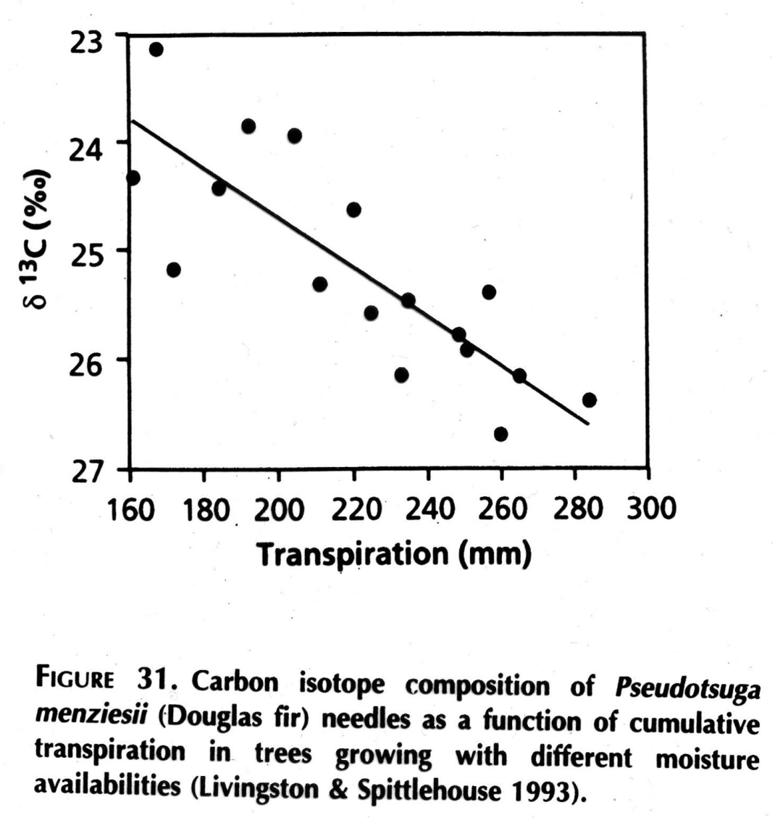
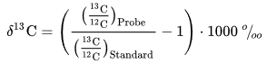
¹³C-Discrimination as a measure for transpiration
more ¹³C assimilated
Atmospheric CO₂ consists of 98,9% ¹²C and 1,1% ¹³C
Rubisco discriminates against ¹³C
if C_{i} is high (high stomatal conductance, high respiration, rubisco prefers ¹²C
if if C_{i} is low because stomata are closed, Rubisco cannot afford to discriminate against ¹³C to that extent
δ ¹³C is calculated from the ratio of ¹³C to ¹²C in the sample and the same ratio in a world-wide standard.
δ ¹³C decreases linearly with increasing transpiration, the highter the rate of transpiration,the more discrimiation aganst ¹³C
less ¹³C assimilated
Notes:
δ ¹³C is a value that can be calculated from the measurement of the ¹³C to ¹²C ratio in plant material.
Atmospheric CO2 consists of 98,9% ¹²C and 1,1% of the heavier C-isotope ¹³C.
Rubisco, the main enzyme in the Calvin cycle prefers to catalyze the reaction of ¹²CO₂ with Ribulose-Bisphosphate, so the percentage of ¹²C in plant material is much higher than 98,8%.
But if Ci is lowered due to stomatal closure, Rubisco cannot afford to be so choosy any more and has to discriminate less against the heavier C-isotope – material from glucose assimilated during these times still contains less than 1,1% ¹³C, but not so much less.
→ δ ¹³C – values are calculated from the ratio of ¹³C to ¹²C in the sample and the same ratio in a globally used standard.
as you can see in the graph, δ ¹³C values decrease linearly with increasing transpiration
→ the higher transpiration, the higher is Ci, the more discriminates Rubisco against ¹³C and the mor negative is δ ¹³C of the resulting plant material.

Slide 47
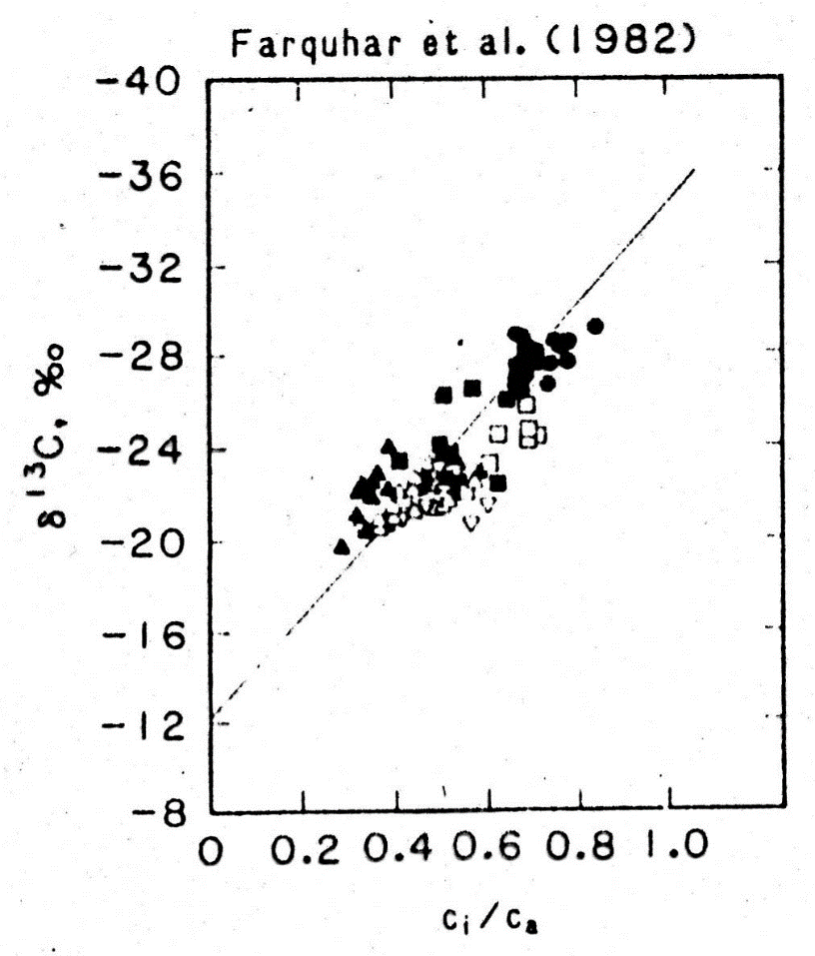
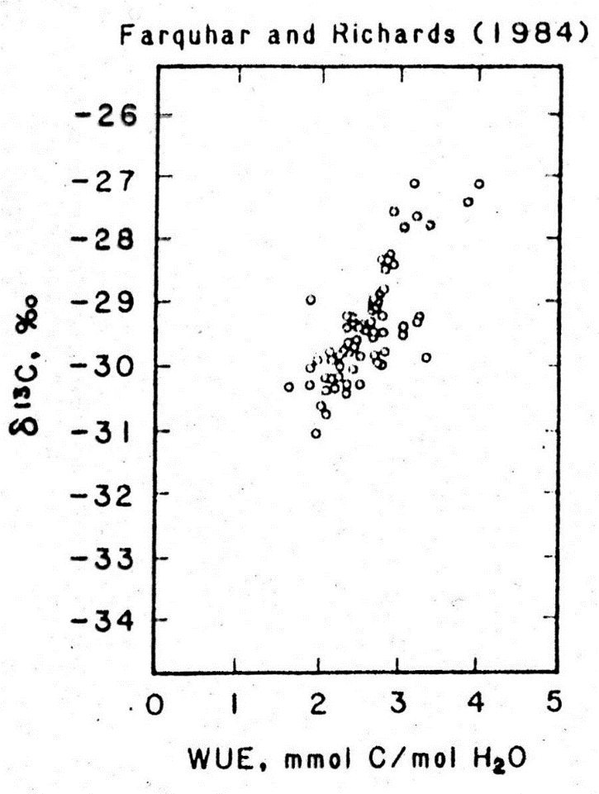
¹³C-Discrimination as a function of C_{i} and WUE
δ ¹³C of plant tissues is an indicator of former rates of stomatal conductance, transpiration and, since these are linked with photosynthesis, WUE
δ ¹³C of plant material is an indicator for the water-stress the plant experienced
since PEP-Carboxylase, the first enzyme to process CO2 in C4 and CAM-plants, does not discriminate δ ¹³C, this value can show which pathway the plant species uses
less ¹³C assimilated
more ¹³C assimilated
more ¹³C assimilated
less ¹³C assimilated
C_{i} = CO₂-concentration in the mesophyll
C_{a} = concentration in the atmosphere
the lower stomatal conductance, the smaller C_{i} / C_{a}
WUE = Water Use Efficiency
= mmol CO₂ assímilated per mol H₂O transpired
Notes:
As the left graph shows, the realitionship between δ ¹³C and the ratio of the CO₂-concentration in the mesophyll C_{i} and the CO₂-concentration in the atmosphere C_{a} is linear as well, since it also depends on stomatal conductance. As is its relationship with WUE as seen in the right diagramm.
These relationships with physiological parameters make δ ¹³C-values of plant tissue a good indicator for the rates of transpiration, Ci to Ca-ratio and Water-use-efficiency and transpiration the plant experienced during the assimilation of the C-compounds of the tissue.
Since all these parameters are defined by stomatal conductance, which is mainly influenced by the Vapour-pressure-deficit and the water-status of plant and soil, δ ¹³C-values are a good indicator for times of water-stress the plant experienced as well
and becaus PEP-carboxylase, the first enzyme that processes CO₂ in C₄ and CAM-plants, does not discriminate against ¹³C, these values can give information about the photosynthesis pathway the plant uses, too.

Slide 48
Adjustments to water stress
plants can acclimate and adapt to water stress in a number of ways:
reduce transpiration: thicker cuticula, grooves and dead hairs on the cuticula and sunken stomata to increase the boundary layer of moister air around the leaf
erect leaves to prevent direct heating of the leaf-blade
avoid drought – e.g. by perseverance in seed form, many desert annuals survive long droughts as seeds and germinate only after rainfalls
endure drought by dying back to the roots or surviving dehydration
employ C₄ or, in extremely dry habitats, CAM-photosynthesis

Slide 49
Abiotic influences on photosynthesis
Several abiotic factors influence the rate of photsynthesis:
Light – driving force
Water – influence on stomatal conductance
CO2 – „raw material“
Temperature – operating temperature of enzymes, changes in sink-strengths
Notes:
Several abiotic factors exert influence on the rate of photosynthesis.
One major factor is obviously light – it is the driving force of photosynthesis
Another one is CO2, which provides the „raw material“
Temperature exerts ist influence mainly via the operating temperatures of the enzymes involved in photosynthetic reactions
Water provides electrons in the light reactions, but its main influence on photosynthesis is via its influence on stomatal conductance and with that on the supply of photosynthesis with CO2
Nitrogen and other nutrients influence photosynthesis, because they are components of the pigments that harvest the light and the enzymes, which catalyse the reactions in photosynthesis.

Slide 50
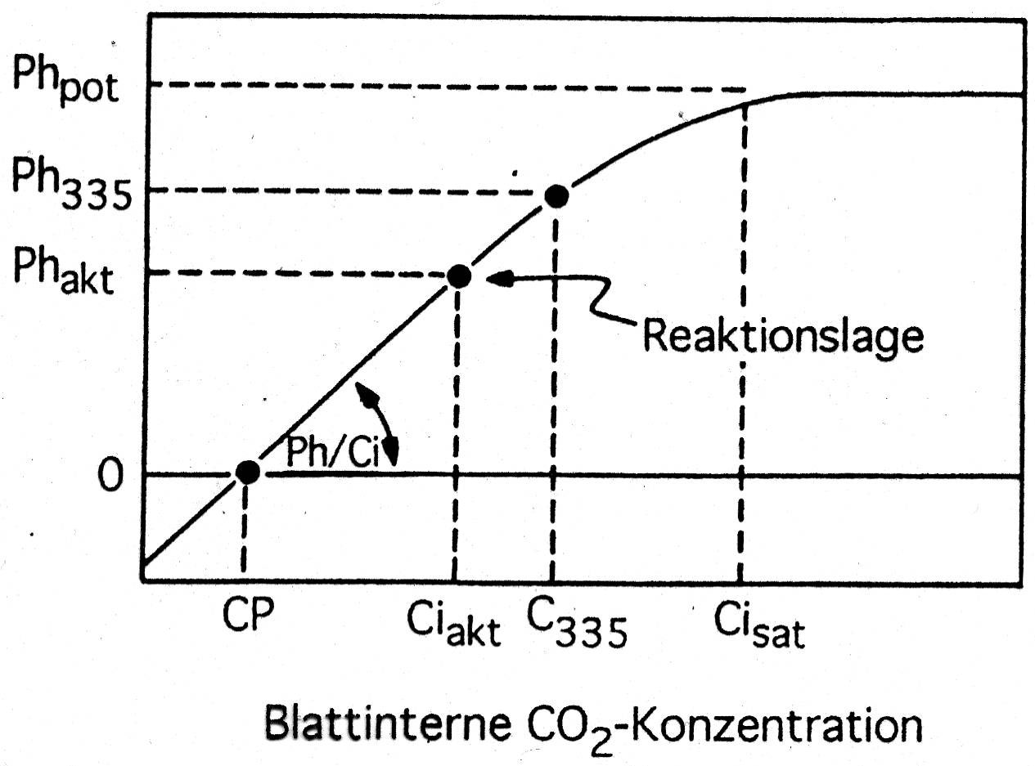
CO₂ response curve (A/Ci-curve)
measured at saturating light intensity
Carboxylation capacity
(light and CO₂-saturation)
A
A
limited by CO₂ concentration
limited by
Calvin cycle
400
A
CO2 gas exchange
Carboxylation efficiency
A
CO₂- compensation
leaf internal CO₂ concentration C_{i}
Notes:
CO2 is the raw material of photosynthesis, so its availability obviously affects the Calvin cycle. But this availability is not only limited by the concentration in the air around the leaf, which is momentarily about 400 ppm, but by the width of the passageway into the leaf, the stomatal pores. Availability of CO2 for photosynthesis is thereby strongly affected by water – both in the air and the soil.
If we examine the response of CO2-gas-exchange - on the Y-axis to the CO2-concentration in the leaves intercellular spaces Ci – on the X-axis, we see a saturation curve much like the light-response curve seen in the last lecture.
With zero Ci no photosynthesis takes place and only the efflux of CO2 from cell respiration can be measured. At low Ci concentrations, assimilation increases linearly. CO2-compensation is reached, when the gas exchange is zero, because assimilation equals respiration.
The ratio of Assimilation to Ci in the linear part of the curve is called the Carboxylation efficiency.
Carboxylation capacity shows the maximum rate of photosynthesis the leaf is capable of with both saturing light-intensitiy and CO2-concentration. When this rate is reached, further increases of Ci do not increase photosynthesis, since maximum capacity of Calvin cycle is reached. As long as photosynthesis increases with increasing Ci, the CO2-concentration in the leaf is the limiting factor.

Slide 51
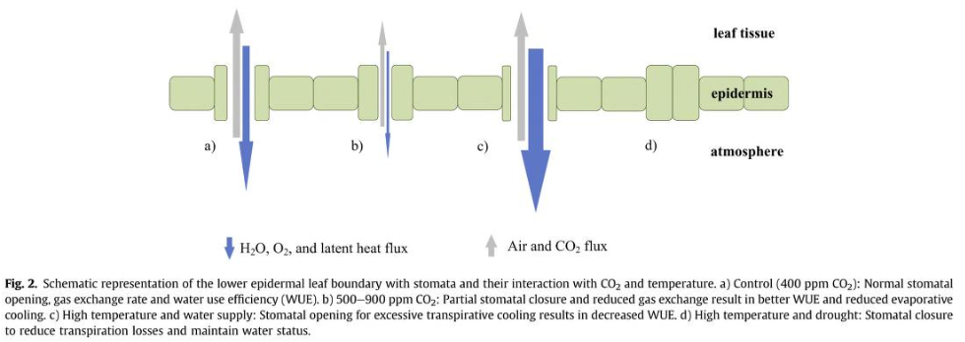
Stomatal responses to elevated CO₂, water supply and temperature
500-900
ppm CO₂
high temperature
and water supply
400 ppm CO₂
drought
Notes:
This is a schematic picture of the response of stomata to CO2-enriched air. The blue arrows indicate the efflux of H2O and with it latent heat out of the leaf, the grey arrows the diffusion of CO2 into the leaf.
gives the control treatment with 400ppm CO2 in the atmosphere around the leaf and a given stomatal conductance
if CO2-concentration is increased to 500-900 ppm, the stomata narrow the passage for water and CO2. Rather than allowing Ci to increase maximally, they restrict transpiration and with it, to a smaller extent, CO2-uptake. In doing this, they increase the water-use-efficiency of photosynthesis
only with high temperature and ample water supply the stomatal pores are opened wider to increase transpiration and cool the leaf.
in drought, on the other hand, the stomatal pores close and Ci sinks to very low values despite the high concentration of CO2 in the atmosphere.
This figure originates from a paper dealing with crops often grown in greenhouses in CO2-enriched air. In a greenhouse, all other factors limiting photosynthesis like light, temperature, water and nutrient supply can be optimized, so an increase of CO2 in the air does indeed increase rates of photosynthesis and growth. In natural ecosystems, photosynthesis is usually limited by other factors than CO2-supply and increases in CO2 are often used by the plants to mitigate the effects of these other factors. For example, they rather lower stomatal conductance to save water instead of using elevated Ci in photosynthesis.

Slide 52
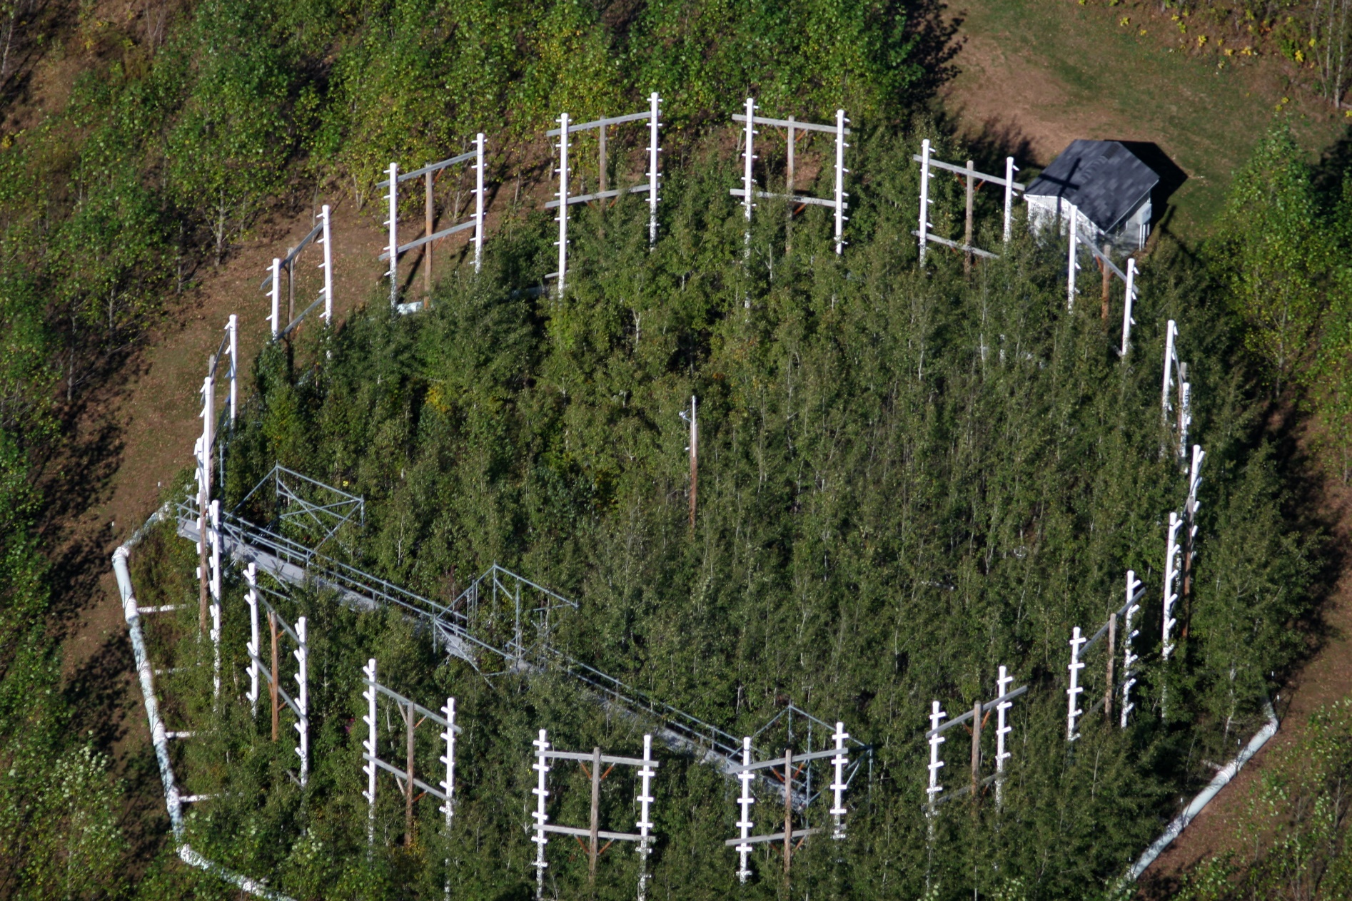
Effects of CO2-enrichment on forests
Conclusions from 10 years of research all around the world:
initial growth effect only
enhanced Non-structural-carbon stores
additional carbon not used for structural growth
carbon no limiting factor for forest growth
possibly forests operate close to C-saturation under present atmospheric CO₂
Carbon limitation in trees
C. Körner 2003 J. Ecology 91
Notes:
There are some data on the effects of CO2-enrichment of the air on trees from natural CO2-springs or large experimental setups.
→ Most of these indicate an initial growth effect of the increased CO2-concentration, which later on vanished.
The trees filled their carbon stores with starch and lipids and effects of water-shortage and shade were mitigated to some extent.
But the trees did not grow higher, they did not invest more structural carbon into stems, branches and roots.
in effect, carbon does not seem to be a limiting factor in tree- and forest growth,
forests worldwide may be operating close to C-saturation already.

Slide 53
Abiotic influences on photosynthesis
Several abiotic factors influence the rate of photsynthesis:
Light – driving force
Water – influence on stomatal conductance
CO2 – „raw material“
Temperature – operating temperature of enzymes, changes in sink-strengths
Notes:
Several abiotic factors exert influence on the rate of photosynthesis.
One major factor is obviously light – it is the driving force of photosynthesis
Another one is CO2, which provides the „raw material“
Temperature exerts ist influence mainly via the operating temperatures of the enzymes involved in photosynthetic reactions
Water provides electrons in the light reactions, but its main influence on photosynthesis is via its influence on stomatal conductance and with that on the supply of photosynthesis with CO2
Nitrogen and other nutrients influence photosynthesis, because they are components of the pigments that harvest the light and the enzymes, which catalyse the reactions in photosynthesis.

Slide 54
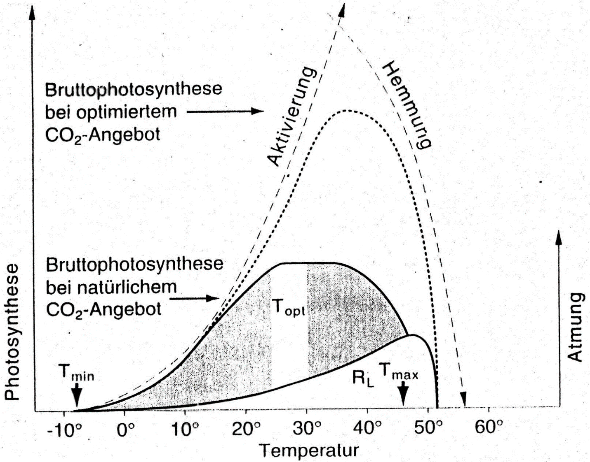
Influence of temperature on photosynthesis and respiration
low temperature:
low enzyme activity
low fluidity of membranes → affects electron transport
high temperature:
high enzyme activity
high membrane fluidity
Gross Photosynthesis with
elevated CO₂
Inhibition
Activation
Gross Photo-
synthesis with
ambient CO₂
Respiration
changed from Ökophysiologie der Pflanzen Larcher 2001
formation of ice crystals at-3 to -5°C,
Dehydration
Denaturation of proteins and damage
of membranes at 50-55°C
Photorespiration
Notes:
All enzymatic processes respond to temperature – enzyme activity increases with rising temperature until an optimum temperature, which is different for different enzymes, is reached. With further rises of temperature, the enzymes activity declines an, being proteins, they are denaturized. Temperature affects membranes the fluidity of membranes following the same pattern: low temperatures reduce the fluidity, which affects membrane-bound processes like the electron transport, high temperatures can damage them. Very low temperatures below 0°C, on the other hand, can cause the formation of ice crystals in the cells which can destroy the whole cell.
This is a schematic diagramm showing the influence of temperature on photosynthesis and respiration. Gross photosynthesis increases with the temperature-induced activation of the involved enzmes, until inhibiting effects cause it to drop again. The same is true for photorespiration or light respiration RL. The shaded curve curve shows net-photosynthesis as the difference between gross-photosynthesis and respiration. The effect of temperature on photorespiration has an indirect component: with rising temperature, the ration of CO2 to O2 shifts towards O2. which in turn increases the oxigenation-activity of Rubisco.
The white zone in the net-photosynthesis curve depicts the optimal temperature, which allows for maximum net photosynthesis.

Slide 55
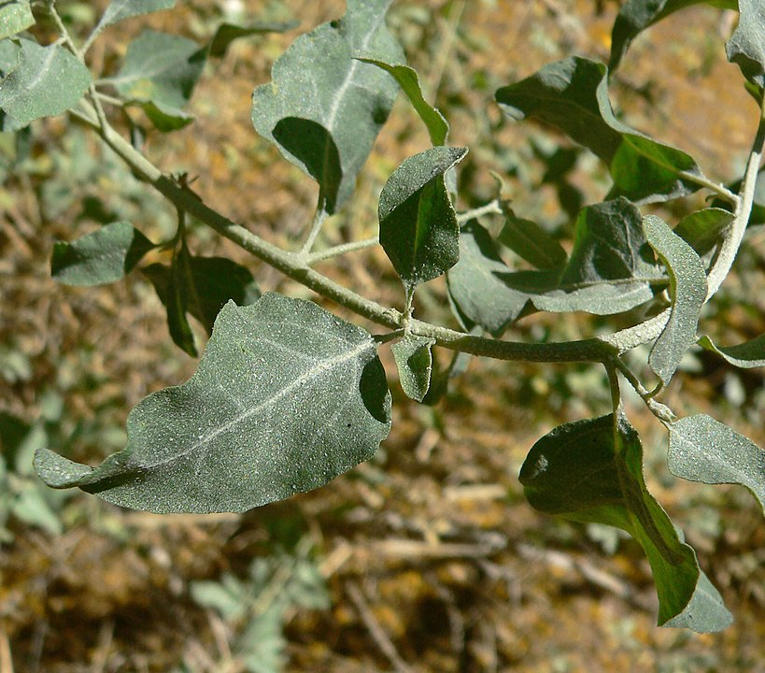
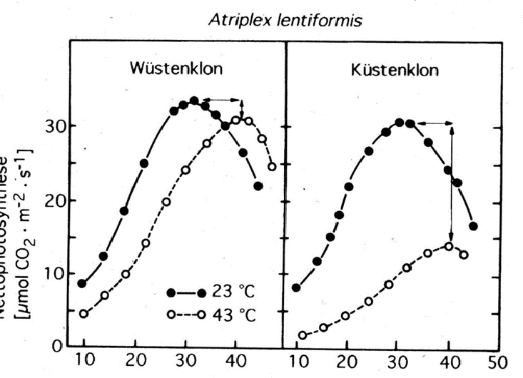
Acclimation to temperature
Desert Clone
Coastal Clone
By Stan Shebs, CC BY-SA 3.0, https://commons.wikimedia.org/w/index.php?curid=5192195
Net-photsynthesis
changed from Ökophysiologie der Pflanzen Larcher 2001
Notes:
Plants are able to adjust both respiration and photsyntheis to some extent to different temperatures.
Atriplex lentiformis, the quail bush or big salt bush, is native to the southwestern USA and northern Mexico. It grows in deserts and along the coast in habitats with saline or alkaline soil.
The graph shows the responses of clones from the hot desert on the left and from the cooler coastal habitat on the right. The X-axis depicts Temperature, the Y-axis Net-photosynthesis. The solid lines represent the responses of plants grown at 23°C, the broken lines the responses of those cultivated at 43°C.
→ All graphs show an optimum curve, but the optimal temperature is shifted to higher temperatures with those clones grown at 43°C. The red arrows indicate the extent of the ability of the plants to acclimatize by shifting their photosynthesis-optimum to higher temperatures.
But while the clone adapted to hot desert environments is able to do so with only small increments in performance – the blue arrows, the coastal clone is able to shift its optimum from ca. 34 to 40°C, but overall performance of photosynthesis has obviousliy suffered from the high temperature at cultivation.

Slide 56

Adaptation to different temperatures
cool coastal dune plant
evergreen desert shrub
Antarctic
Lichen
summeractive desert plant
Notes:
Species Adaptation to temperature can cover a broad range of habitats – Antarctic lichens can still reach 60% of ther maximum photosynthesis at -5°C, but rates rapidly decline above 10°C. Tidestromia, Honeysweet, a summeractive perennial growing in deserts of the western US, Mexico and tropical America, represents the other end of the spectrum – the plants only reach their maximum rates of photosynthesis at 40°C.
Adaptation to high temperatures generally happen on a biochemical level: Since reaction kinetics of enzymes are susceptible to temperature, adjustments to temperature often involve chemical and structural changes of the proteins involved in photosynthesis and respiration. One regular response is the stimulation of enzymes involved in respiration as response to low temperature, the dampening of the activity of these enzymes in high temperatures.
Since plants growing in hot habitats regularly experience high light intensities and water shortage as well, they usually also evolved adaptations to these conditions. The most important ones are those reducing transpiration, from sunken stomata and thick cuticles with structures like hairs or grooves that reduce the air flow at the leaf surface to CAM-metabolism.

Slide 57

Mechanisms of Acclimation and Adaptation to temperature
Yamori, W., Hikosaka, K. & Way, D.A. Photosynth Res (2014) 119: 101. https://doi.org/10.1007/s11120-013-9874-6
Fig. 2 A classic, idealized diagram of temperature acclimation of the response of photosynthesis to temperature. The proposed mechanisms underlying the temperature acclimation of photosynthesis are summarized
Notes:
Acclimation and Adaptation to high temperatures generally happen on a biochemical level: Since reaction kinetics of enzymes are susceptible to temperature, adjustments to temperature often involve increases in quantity and / or chemical and structural changes of the proteins involved in photosynthesis and respiration and .
Acclimation to low temperatures involves increases in the contents of photosynthetic enzymes, the expression of cold stable isozymes (proteins with the same chemical formula but different spatial form) and the maintanance of greater membrane fluidity.
Plants growing in very warm habitats often increase their electron transport capacity, express a heat stable Rubisco activase and proteins, that protect the enzymes (chaperones and heat shock proteins).
One regular response is the stimulation of enzymes involved in respiration as response to low temperature, the dampening of the activity of these enzymes in high temperatures.
Since plants growing in hot habitats regularly experience high light intensities and water shortage as well, they usually also evolved adaptations to these conditions. The most important ones are those reducing transpiration, from sunken stomata and thick cuticles with structures like hairs or grooves that reduce the air flow at the leaf surface to CAM-metabolism.

Slide 58

Destructive and Non-destructive Methods
Responses of forest trees to multiple stresses 2010 U. Niinemets Forest Ecology and Management 260, 1623-1639
Notes:
This lecture only covered the main factors influencing photosynthesis and growth of plants. Other factors can limit them as well, such as nutrient, especially nitrogen, availability, which can limit the formation of proteins.
In addition to these abiotic factors, there are numerous biotic factors that limit plant growth.
This figurre summarizes some destructive and non-destructive methods used to investigate the effects of stresses on plants on molecular, biochemical, physiological and morphological levels.

Slide 59
References:
Ökophysiologie der Pflanzen: Leben, Leistung und Stressbewältigung der Pflanzen in ihrer Umwelt. Walter Larcher (2001) UTB Stuttgart, ISBN-10: 3825280748
The Ecology of plants Jessica Gurevitch, Samuel M. Scheimer, Gordon A Fox, Sinauer Associates, Oxford University Press, 2nd edition 2006
Temperature response of photosynthesis in C3, C4 and CAM plants: temperature acclimation and temperature adaptation Wataru Yamori, Kouki Hikosaka & Danielle A. Way, Photosythesis research 119, 101-117
Ökophysiologie der Pflanzen: Leben, Leistung und Stressbewältigung der Pflanzen in ihrer Umwelt. Walter Larcher (2001) UTB Stuttgart, ISBN-10: 3825280748
The Ecology of plants Jessica Gurevitch, Samuel M. Scheimer, Gordon A Fox, Sinauer Associates, Oxford University Press, 2nd edition 2006
Temperature response of photosynthesis in C3, C4 and CAM plants: temperature acclimation and temperature adaptation Wataru Yamori, Kouki Hikosaka & Danielle A. Way, Photosythesis research 119, 101-117

Slide 60
References
Carbon limitation in trees Christian Körner, 2003 Journal of Ecology 91, 4-17
Temperature response of photosynthesis in C3, C4 and CAM plants: temperature acclimation and temperature adaptation Wataru Yamori, Kouki Hikosaka & Danielle A. Way, Photosythesis research 119, 101-117
Modelling carbon sources and sinks in terrestrial vegetation Simone Fatichi, Christoforos Pappas, Jakob Zscheischler & Sebastian Leuzinger 2019 New Phytologist 221: 652-668
Ökophysiologie der Pflanzen: Leben, Leistung und Stressbewältigung der Pflanzen in ihrer Umwelt. Walter Larcher (2001) UTB Stuttgart, ISBN-10: 3825280748
Responses of forest trees to single and multiple environmental stresses from seedlings to mature plants: Past stress history, stress interactions, tolerance and acclimation Ülo Niinemets 2010 Forest Ecology and Management 260, 1623-1639
stella.aspelmeier@biologie.uni-goettingen.de

